Slide 1


13th International Motorcycle Conference, Sept 1 – Oct 6, 2020, IFZ, Essen, Germany
eXPERIMENTAL STUDY ON LANE CHANGe maneuvers WITH A mOTORCYCLE
Stefan Litschauer
Horst Ecker
TU-Wien
Vienna University of Technology

Slide 2
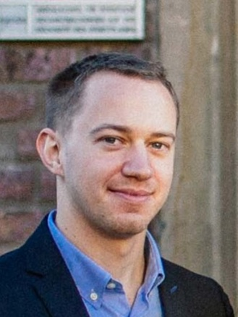
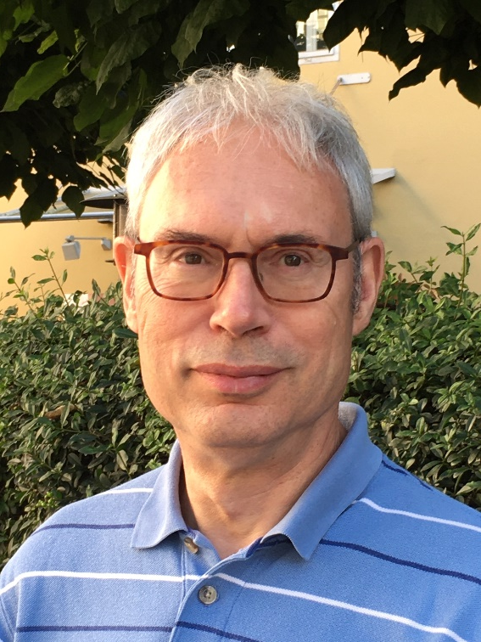
13th International Motorcycle Conference, Sept 1 – Oct 6, 2020, IFZ, Essen, Germany
eXPERIMENTAL STUDY ON LANE CHANGe maneuvers WITH A mOTORCYCLE
Stefan Litschauer
Horst Ecker
TU-Wien
Vienna University of Technology

Slide 3
13th International Motorcycle Conference, Sept 1 – Oct 6, 2020, IFZ, Essen, Germany
A generic mathematical model of the lane change maneuver for dynamic studies and control purposes.
The Goal
The Method
Measuring dynamics data using an intrumented motorcycle and conducting riding experiments.
The Result
Data mining and a heuristic approach leads to a parameterized mathematical model.
Reaction time measurements were carried based on an external visual trigger signal.
Extra results
Litschauer / Ecker – Experimental and theoretical study on motorcycle lane change maneuvers

Slide 4
13th International Motorcycle Conference, Sept 1 – Oct 6, 2020, IFZ, Essen, Germany
A generic mathematical model of the lane change maneuver for dynamic studies and control purposes.
The Goal
Measuring dynamics data using an intrumented motorcycle and conducting riding experiments.
The Method
Data mining and a heuristic approach leads to a parameterized mathematical model.
The Result
Reaction time measurements were carried based on an external visual trigger signal.
Extra results

Slide 5
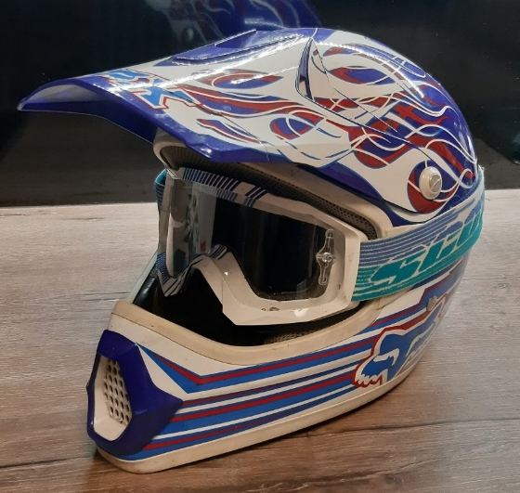
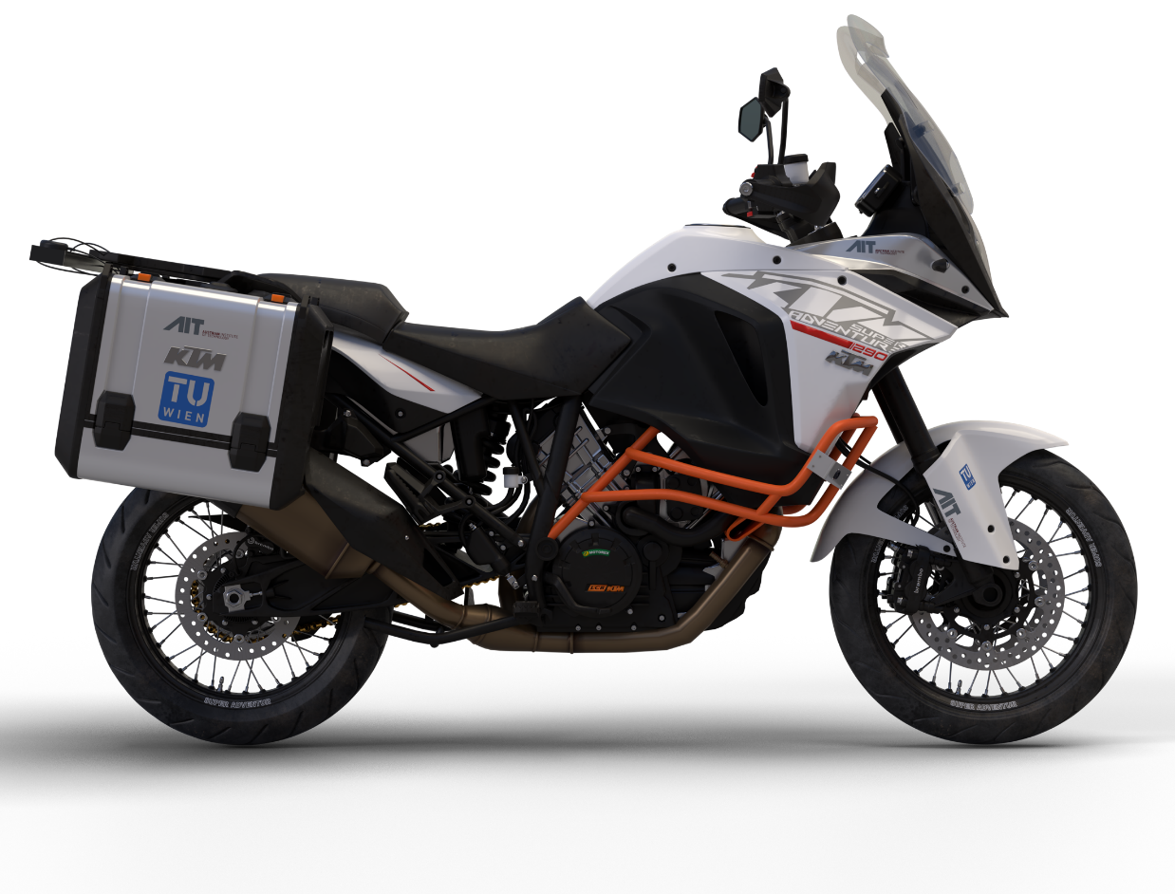
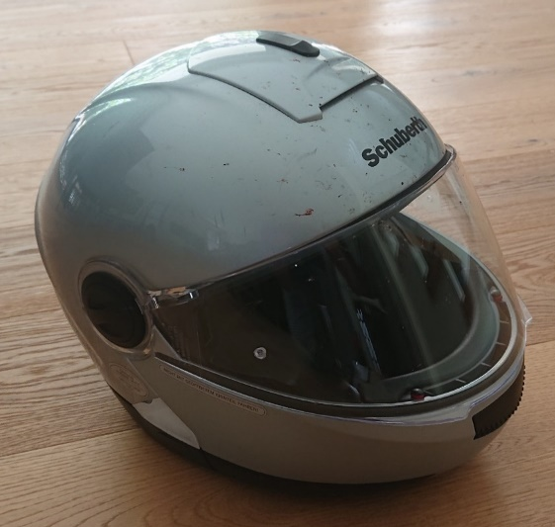
13th International Motorcycle Conference, Sept 1 – Oct 6, 2020, IFZ, Essen, Germany
Two Riders - One Motorcycle
SL
HE

Slide 6
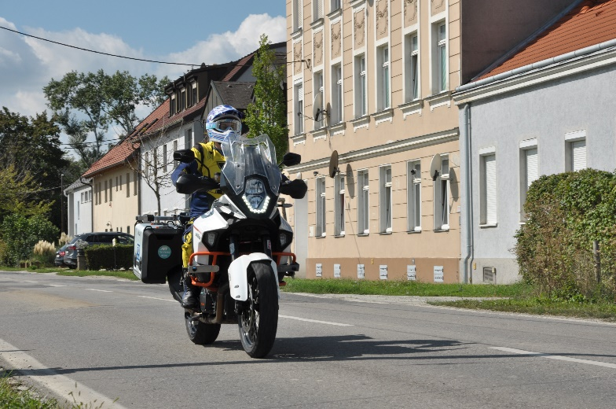
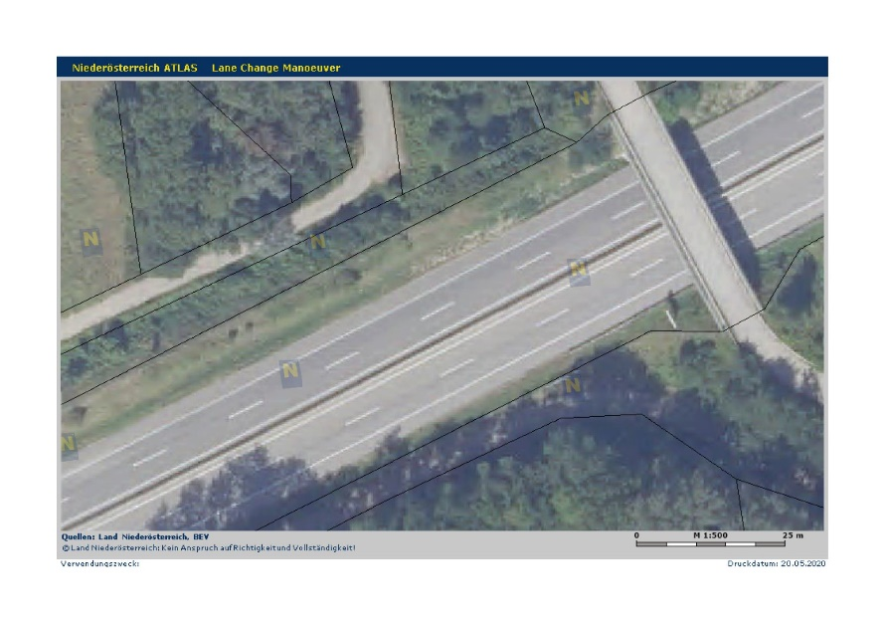
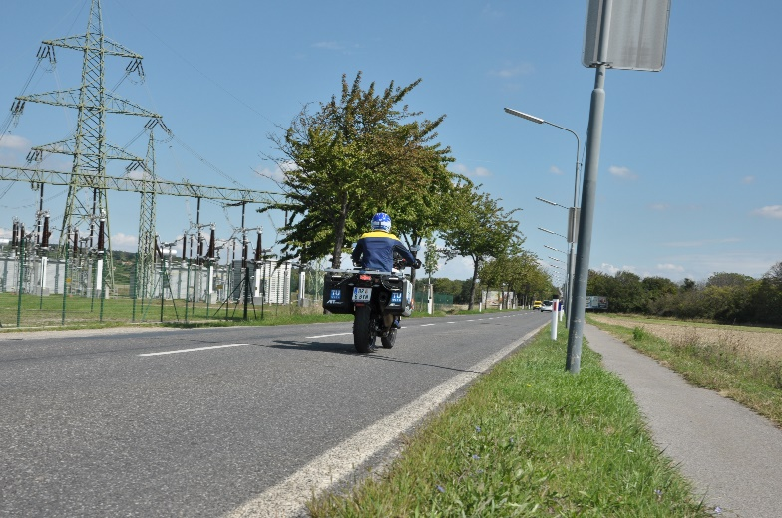
13th International Motorcycle Conference, Sept 1 – Oct 6, 2020, IFZ, Essen, Germany
Highways
Urban roads
Country roads

Slide 7
13th International Motorcycle Conference, Sept 1 – Oct 6, 2020, IFZ, Essen, Germany
Urban roads
Highways
Country roads
Known distance

Slide 8
13th International Motorcycle Conference, Sept 1 – Oct 6, 2020, IFZ, Essen, Germany
Urban roads
Highways
max. 130 km/h
Driving Path
max. 50 km/h
Country roads
max. 100 km/h

Slide 9
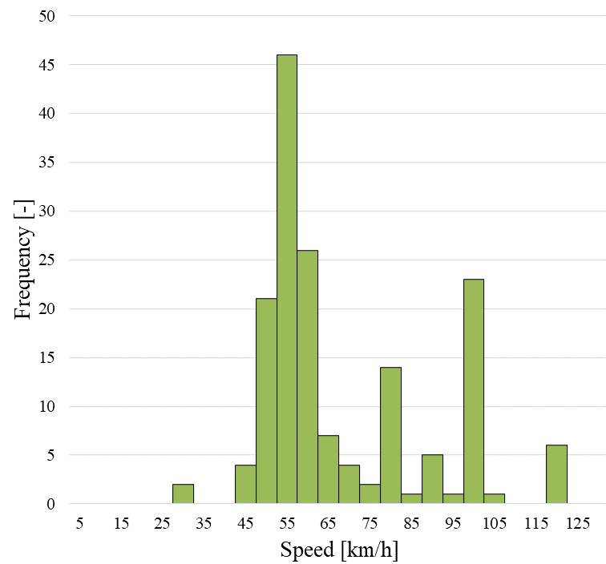
13th International Motorcycle Conference, Sept 1 – Oct 6, 2020, IFZ, Essen, Germany
Speed range covered by experiments

Slide 10
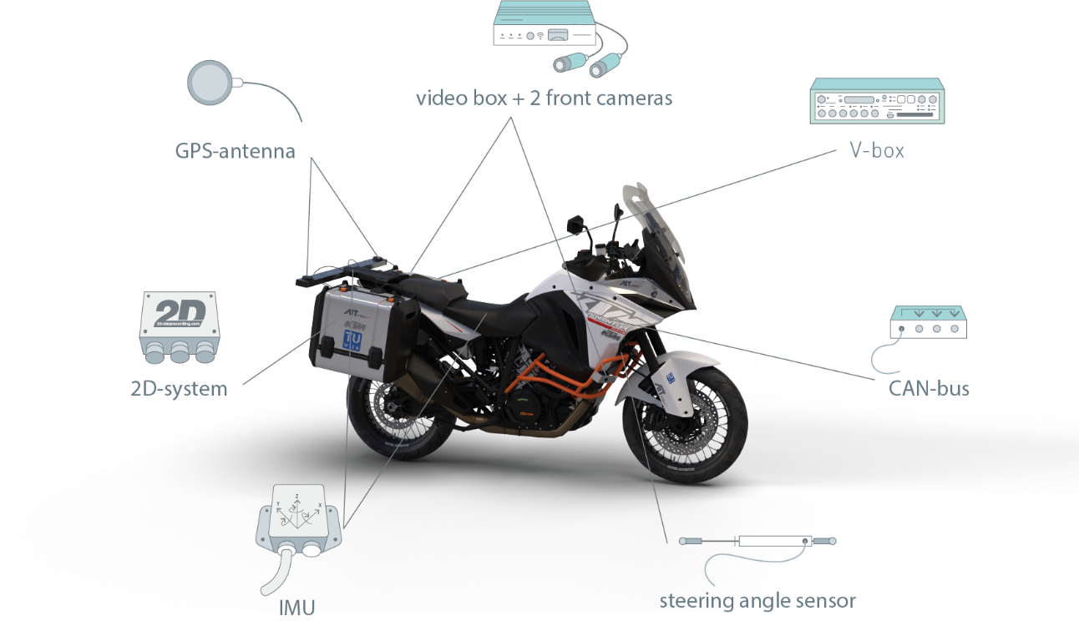
13th International Motorcycle Conference, Sept 1 – Oct 6, 2020, IFZ, Essen, Germany
The Probe Vehicle
Motion Signals (displacement, angles, velocities, accelerations, wheel speeds, etc.)
Vehicle signals (engine speed, throttle position, brake pressure, etc.)
Position signals (GPS-data)
Video signals (Two on-board cameras)

Slide 11
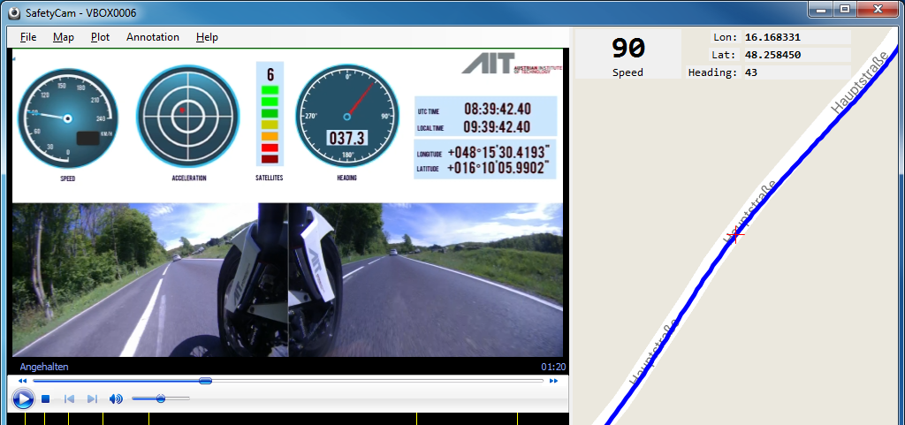
13th International Motorcycle Conference, Sept 1 – Oct 6, 2020, IFZ, Essen, Germany

Slide 12
13th International Motorcycle Conference, Sept 1 – Oct 6, 2020, IFZ, Essen, Germany
A generic mathematical model of the lane change maneuver for dynamic studies and control purposes.
The Goal
Measuring dynamics data using an intrumented motorcycle and conducting riding experiments.
The Method
Data mining and a heuristic approach leads to a parameterized mathematical model.
The Result
Reaction time measurements were carried based on an external visual trigger signal.
Extra results

Slide 13
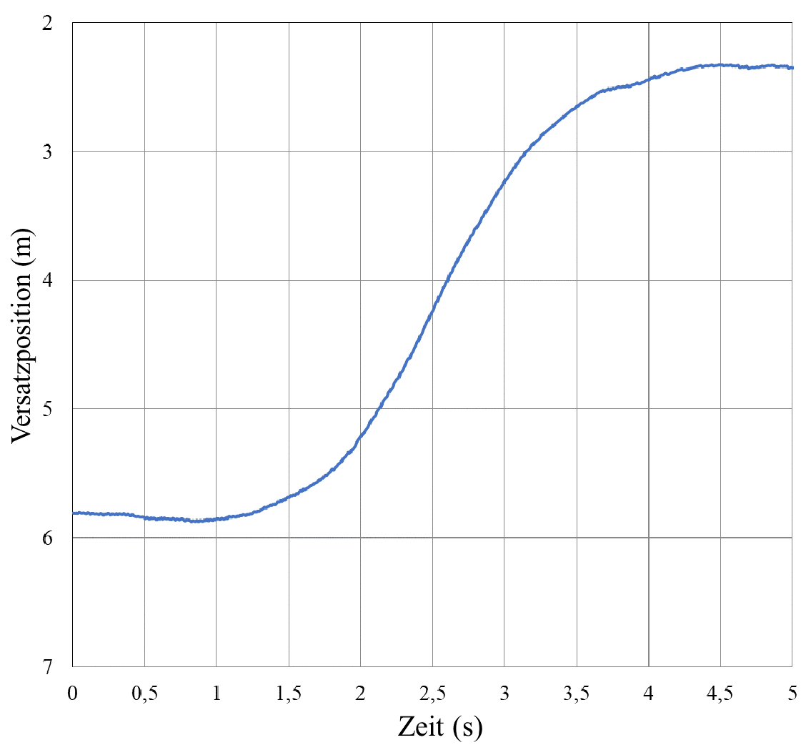
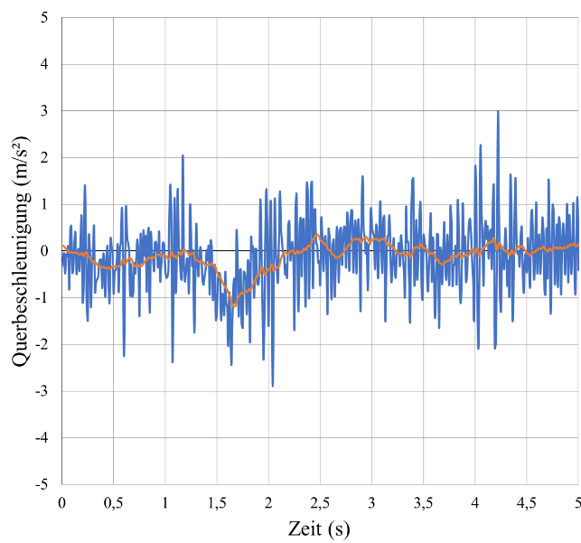
13th International Motorcycle Conference, Sept 1 – Oct 6, 2020, IFZ, Essen, Germany
Lateral diplacement – Lane change to the left @ 52 km/h
Lateral acceleration – Lane change to the left @ 52 km/h

Slide 14
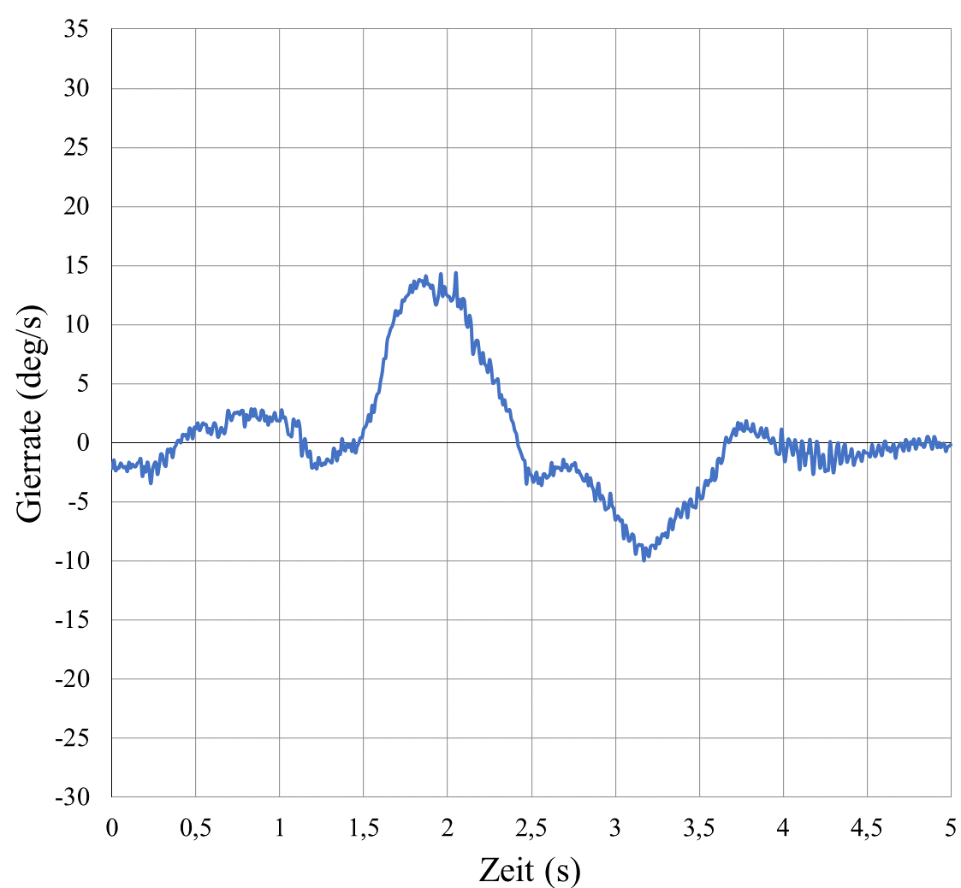
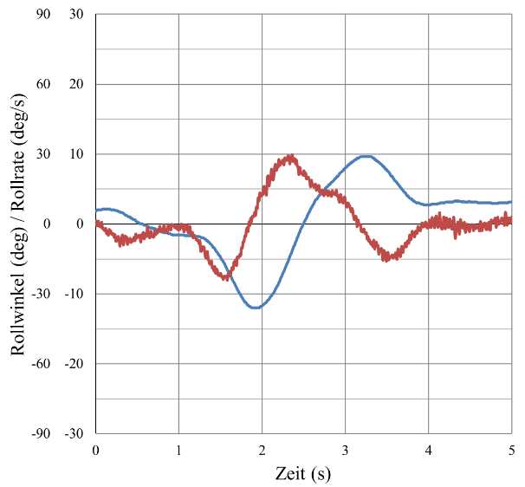
13th International Motorcycle Conference, Sept 1 – Oct 6, 2020, IFZ, Essen, Germany
Yaw rate– Lane change to the left @ 52 km/h
Roll angle (blue) / Roll rate (red) – Lane change to the left @ 52 km/h

Slide 15
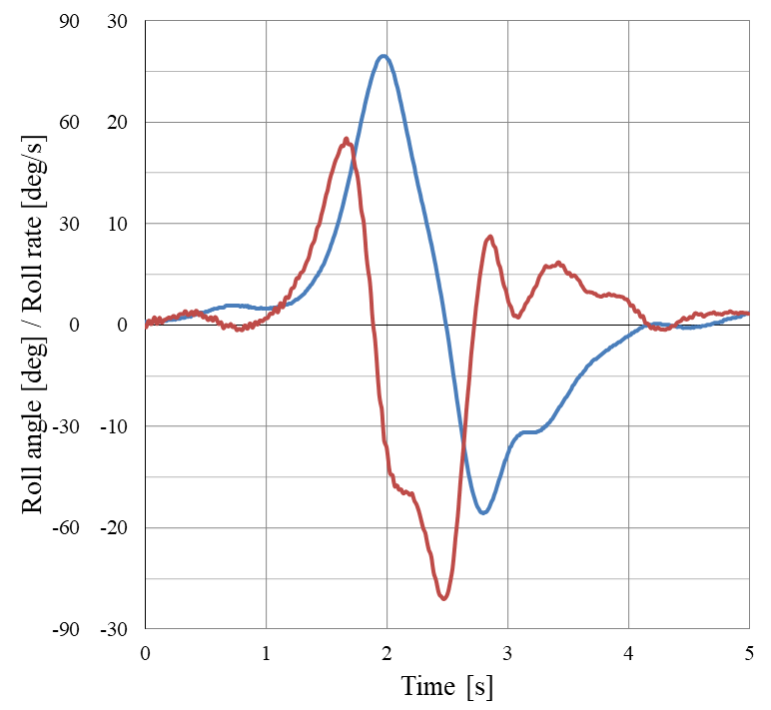
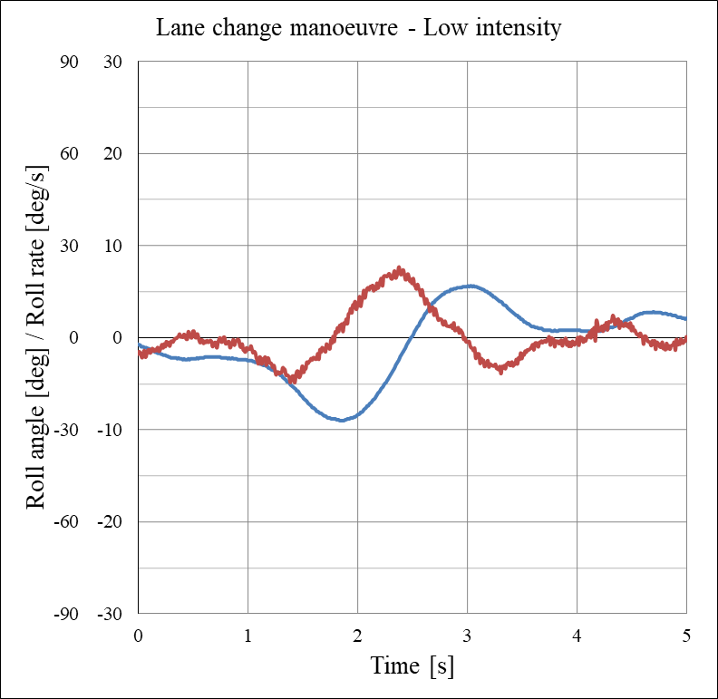
13th International Motorcycle Conference, Sept 1 – Oct 6, 2020, IFZ, Essen, Germany
High Intensity lane change @ 79 km/h (49 mph)
Low Intensity lane change @ 58 km/h (36 mph)

Slide 16
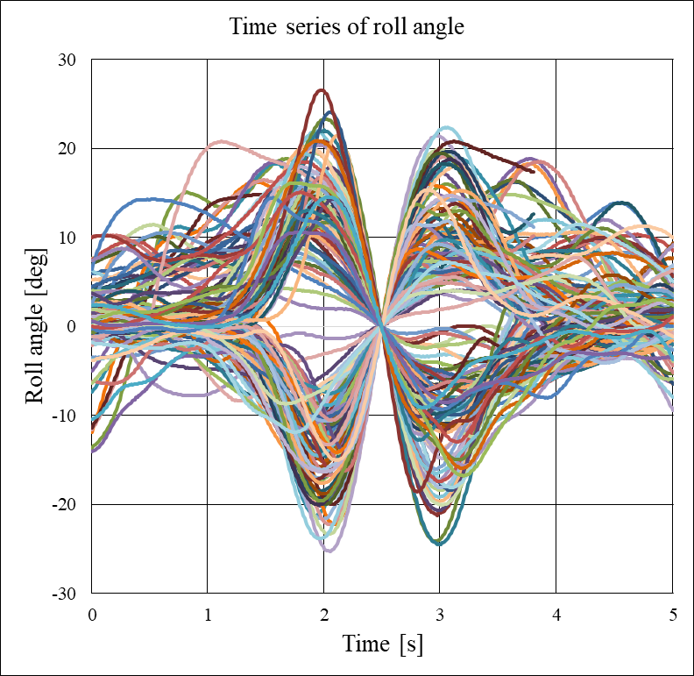
13th International Motorcycle Conference, Sept 1 – Oct 6, 2020, IFZ, Essen, Germany
Time series of roll angles of all measured lane change maneuvers at all speeds, synchronized by the zero crossing of the roll angle approximately in the middle of the lane change.

Slide 17
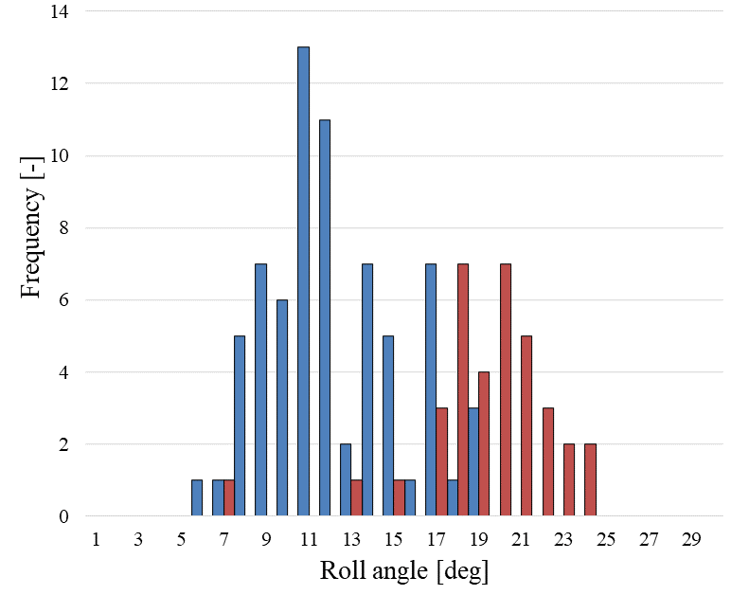
13th International Motorcycle Conference, Sept 1 – Oct 6, 2020, IFZ, Essen, Germany
Histogram of maximum roll angle at low speeds of both riders; blue (HE) red (SL)
Notes:
.

Slide 18
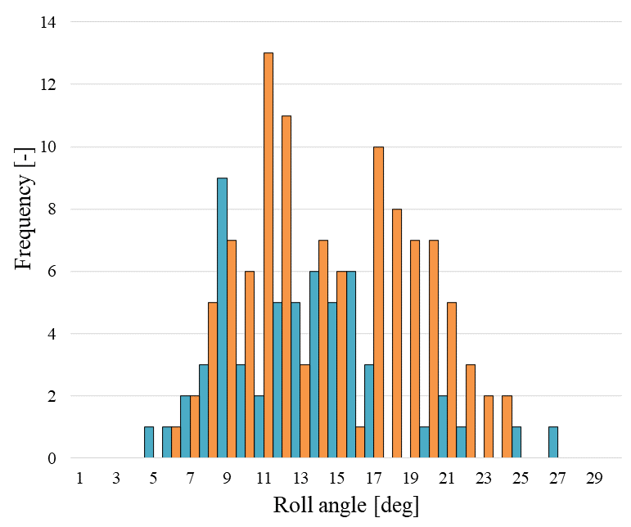
13th International Motorcycle Conference, Sept 1 – Oct 6, 2020, IFZ, Essen, Germany
Histogram of roll angle at all speeds of both riders; orange (HE+SL @ low speed), blue (high speed)
Roll Angle (deg)

Slide 19
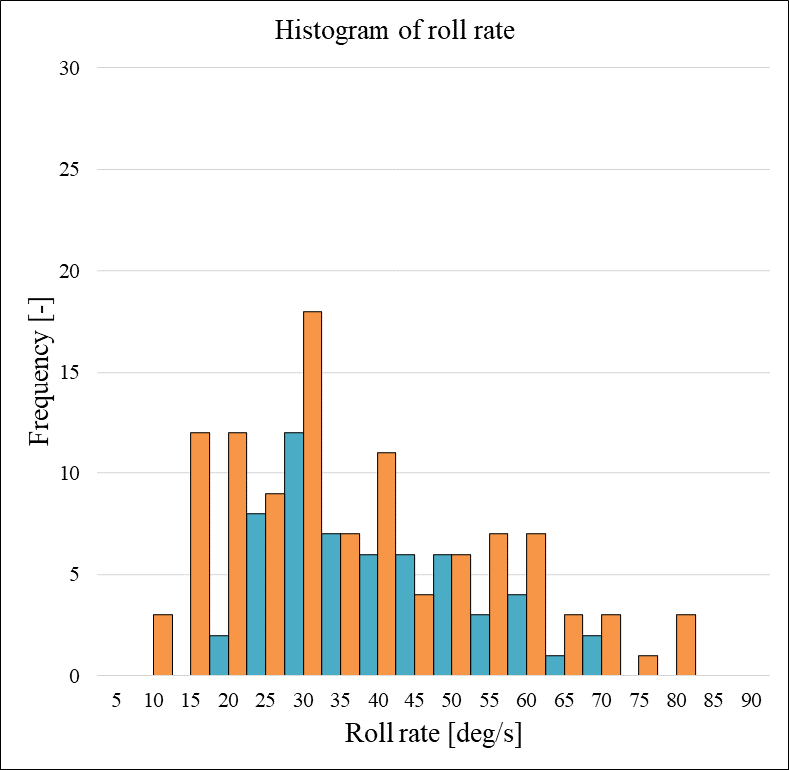
13th International Motorcycle Conference, Sept 1 – Oct 6, 2020, IFZ, Essen, Germany
Histogram of roll angle at all speeds of both riders; orange (HE+SL @ low speed), blue (high speed)
Histogram of the roll rate at all speeds of both riders; orange (HE+SL @ low speed), blue (high speed)
Roll Angle (deg)
Roll Rate (deg/s)

Slide 20
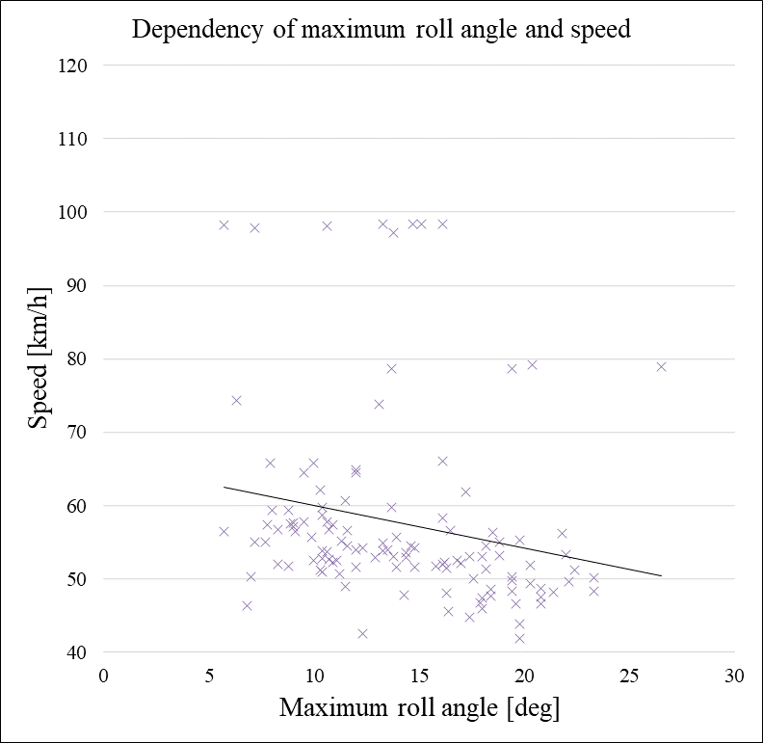
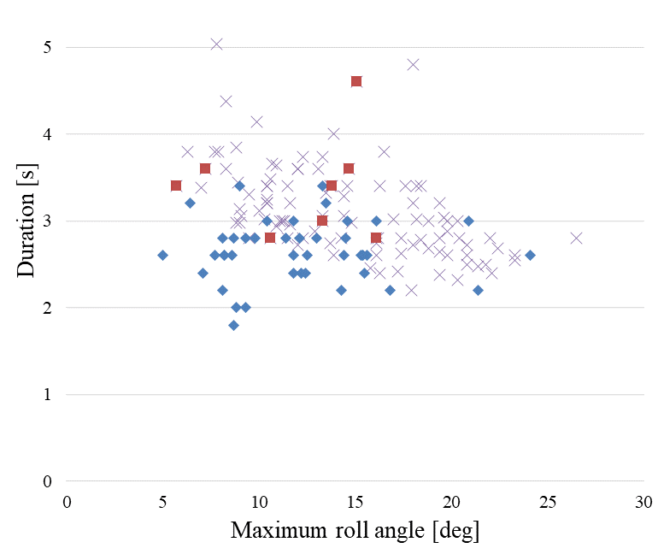
13th International Motorcycle Conference, Sept 1 – Oct 6, 2020, IFZ, Essen, Germany
Speed versus maximum roll angle for full lane changes
Dependency of the lane change duration on the maximum roll angle
High speed
Half lane ch. ◊

Slide 21
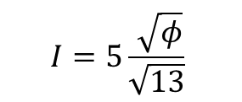
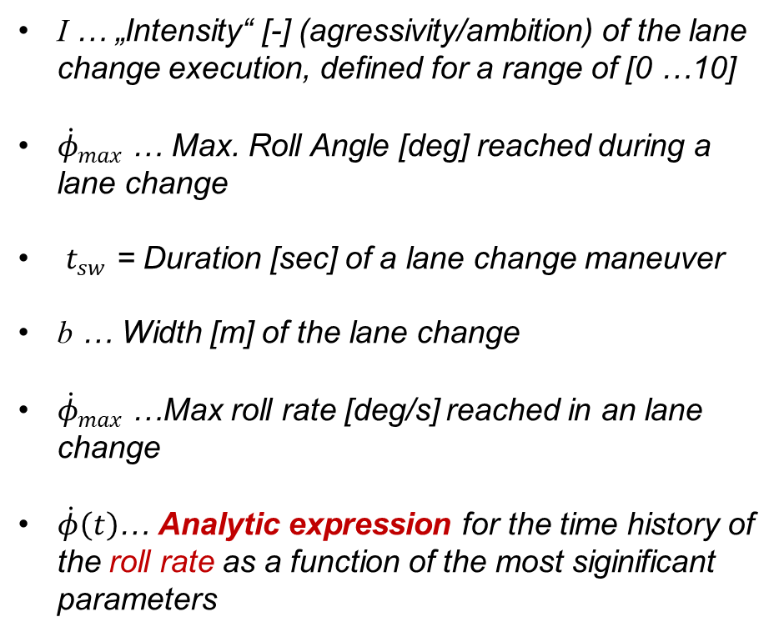
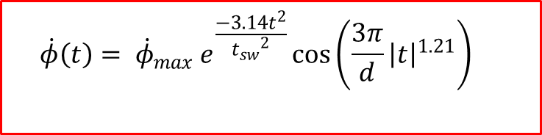
13th International Motorcycle Conference, Sept 1 – Oct 6, 2020, IFZ, Essen, Germany
Data Mining Results
I … „Intensity“ [-] (agressivity/ambition) of the lane change execution, defined for a range of [0 …10]
${\dot{φ}}_{max}$ … Max. Roll Angle [deg] reached during a lane change
$t_{sw}$ = Duration [sec] of a lane change maneuver
b … Width [m] of the lane change
${\dot{φ}}_{max}$ …Max roll rate [deg/s] reached in an lane change
$\dot{φ}\left(t\right)$… Analytic expression for the time history of the roll rate as a function of the most siginificant parameters
$$I=5\frac{ \sqrt{φ}}{\sqrt{13}}$$
$$t_{sw}=−0.2346 I+0.3379 b+3.1715$$
$${\dot{φ}}_{max}=11.5724 I−10.5877 t_{sw}+13.4428$$
$$\dot{φ}\left(t\right)= {\dot{φ}}_{max} e^{\frac{−3.14t^{2}}{{t_{sw}}^{2}}}\cos\left(\frac{3π}{d}{\left|t\right|}^{1.21}\right)$$

Slide 22
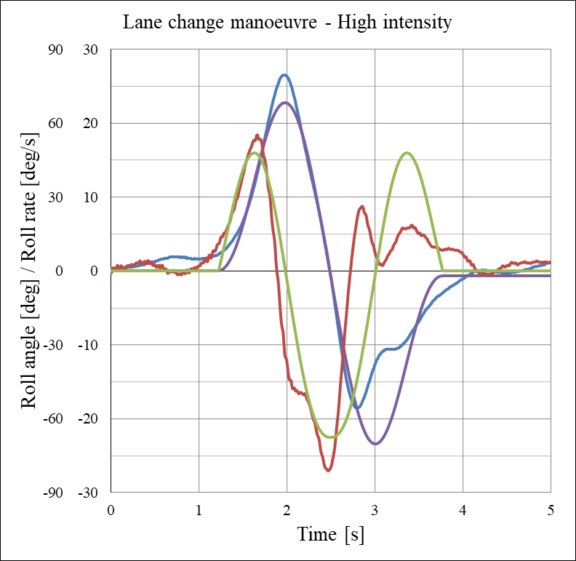
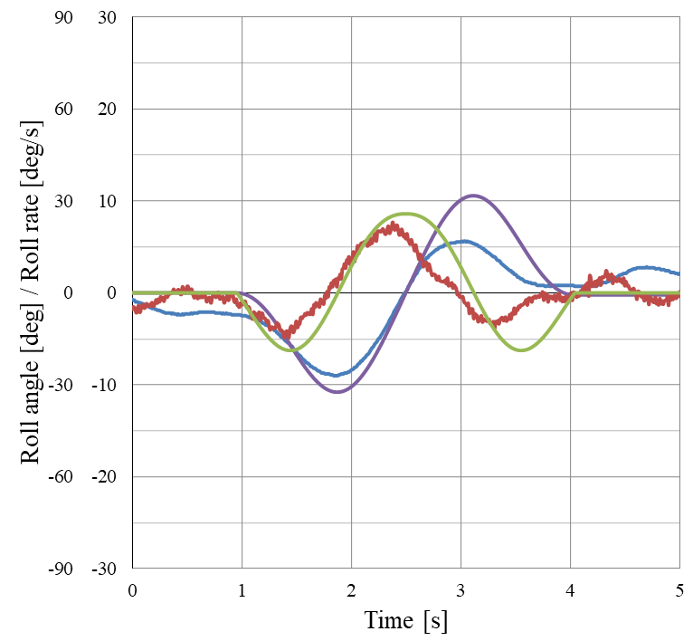
13th International Motorcycle Conference, Sept 1 – Oct 6, 2020, IFZ, Essen, Germany
Comparison of measured and synthetic signals
High Intensity lane change @ 79 km/h (49 mph)
Low Intensity lane change @ 58 km/h (36 mph)

Slide 23
13th International Motorcycle Conference, Sept 1 – Oct 6, 2020, IFZ, Essen, Germany
A generic mathematical model of the lane change maneuver for dynamic studies and control purposes.
The Goal
Measuring dynamics data using an intrumented motorcycle and conducting riding experiments.
The Method
Data mining and a heuristic approach leads to a parameterized mathematical model.
The Result
Reaction time measurements were carried based on an external visual trigger signal.
Extra results

Slide 24
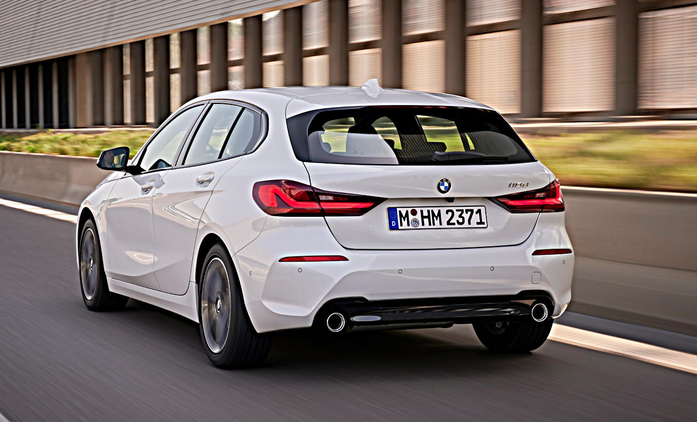
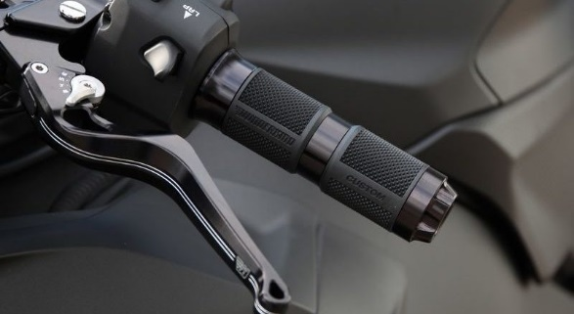
13th International Motorcycle Conference, Sept 1 – Oct 6, 2020, IFZ, Essen, Germany
Micro-Switch
to
detect steering action
Steering
Action
Reaction
Time
Measure-ments
Visual signal activated by car driver is recorded by on-board cameras

Slide 25
13th International Motorcycle Conference, Sept 1 – Oct 6, 2020, IFZ, Essen, Germany
Statistical parameters of the „Steering Reaction Time“
Test Series | n | x̅ | x̃ | σ | MIN | MAX
HE1 | 16 | 0,83 | 0,77 | 0,35 | 0,27 | 1,58
HE2 | 20 | 0,74 | 0,58 | 0,32 | 0,46 | 1,47
SL1 | 16 | 0,53 | 0,50 | 0,16 | 0,34 | 0,85
HE | 36 | 0,78 | 0,69 | 0,33 | 0,27 | 1,58
SL | 16 | 0,53 | 0,50 | 0,16 | 0,34 | 0,85
Total | 52 | 0,70 | 0,61 | 0,31 | 0,27 | 1,58

Slide 26
13th International Motorcycle Conference, Sept 1 – Oct 6, 2020, IFZ, Essen, Germany
A generic mathematical model of the lane change maneuver was developed.
The Summary
As the most influencial parameters, the maneuver „intensity“, the width of the lane change and the max. roll rate were identified.
Further riding experiments will be carried out to collect more data and to verify the results.
The Outlook

Slide 27


13th International Motorcycle Conference, Sept 1 – Oct 6, 2020, IFZ, Essen, Germany
Thank you for your interest and attention !
The authors would like to thank Manfred Neumann for his valuable help when carrying out the measurements.
The authors are grateful to KTM Motorcycles Inc. for providing the motorcycle used in this study.

