Slide 1
EDR for Motorcycles
Possibilities and Benefits of EDR for Motorcycles
Kees Duivestein & Jan Paul Peters
Contribution to the online 13th International Motorcycle Conference by IFZ Cologne
Notes:
Goodmorning, a warm welcome to you all, dear fellow-participants in this IFZ-conference. My name is Kees Duivestein and I'm happy to use this opportunity to talk about EDR and Motorcycles.
The work in the field of regulations by colleque Jan Paul Peters and my recent work concerning In-Vehicle-Data, our common interest in safety in motorcycling and the far-reaching technological developments and possibilities, have led us to this path of EDR for Motorcycles.
For us, it is a true honor to participate in this conference.

Slide 2
EDR for Motorcycles
Research question:
Three questions will be answered:
What is the state of art, what has been published.
Can a motorcycle EDR provide useful data to analyse an accident.
What are the benefits of motorcycles equipped with EDRs for traffic safety
Notes:
The three research questions speak for themselves.
The first step -as it ought to be done- is about what has been published about this topic.
The second question is a fundamental question: can a Motorcycle-EDR provide useful data when it comes to accidents.
And third: what will be de benefit of EDR in motorcycles.
Safety has been and will be a major issue, when is comes to motorcycles.
But with the widespread use of electronics in motorcycles as we see now, the time has come in which it's possible to implement EDR in large-scale.

Slide 3
EDR for Motorcycles
Contents
- introduction -
1. EDR
2. State of the art
3. Accident Analyses
4. Conclusions and Recommendations
Notes:
These are the topics we will discuss further in this paper and in this presentation.
Of course we will present a definition of EDR, so we have a common understanding of it. We will talk about published scientific papers. With 2 real live accident analyses we are able tot explain the possibilities of EDR, And finally, we draw our conclusions and offer some recommandations.

Slide 4
EDR for Motorcycles
introduction: EUDARTS
European Data Analysis Research Training & Service
association of experts and trainers
in more than 30 countries
cooperates with 23 European police forces and 500+ private enterprises.
MODARTS division focuses at EDR for Powered Two Wheelers (PTW’s).
‘MODARTS aims to facilitate and encourage the development and usage of EDR in PTW’s and will offer services in the field of diagnosis and analyses, training & service in respect to EDR for PTW’s. This is our contribution to safety of motorcycling and other PTW’s.’
Notes:
As introduction: we are part of EUDARTS. EUDARTS provides training and services about tools, obtaining and analising data form EDR-devices, mostly from passenger cars. The origin lies in a project with the Dutch National Police. EUDARTS now is the market leader in support and training about EDR data from cars.
MODARTS is the recent initiative focussing at Powered Two Wheelers.

Slide 5
EDR for Motorcycles
Event Data Recorder (EDR)
EDR is a device or function that records the measurements
of vehicle speed and other vehicle conditions
in chronological order before, during, and after
a pre-defined event such as collision, happens.
Notes:
:et us start with a proper definition of Event Data Recorder.
Event Data Recorder (EDR)
EDR is a device or function that records the measurements of vehicle speed and other vehicle conditions, in order before, during, and after a pre-defined event happens, such as collision involving the deployment of an air bag.
Data obtained from EDR will provide information on accident causation. This will allow researchers to better assess the effectiveness of countermeasures, manufacturers to improve future vehicle design and it will allow to determine the liability for the accident, more accurately and objectively, therefore reducing time and legal costs and providing road users and society the access to justice.
There are many misconceptions about the Event Data Recorder. For the correct understanding, n our paper we provide deliver a historical perspective to EDR. For example, the EDR is not a black box like the Flight Recorder; it certainly is not a tape recorder recording rider behaviour during the ride. The misunderstandings sometimes also lead to improper questions and unrest about privacy.

Slide 6
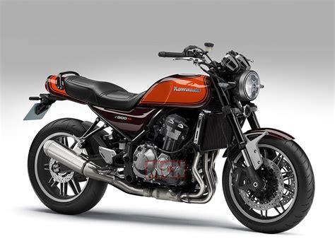
EDR for Motorcycles
State of the Art
Kawasaki Z900RS 2020
Notes:
Science
On one hand, not much has been published on this topic and OEMs are reluctant to provide information about EDR applications. On the other hand: Kawasaki is both far and transparent in this regard. High five!
Current application in motorcycles
The (US) Honda model Gold Wing Airbag 2006-2014, was probably the first motorcycle to have EDR. The EDR was to be triggered in relation to the airbag sensors, like in cars. For cars in general this is the link between airbags and EDR.
About Kawasaki it is known from user manuals that EDR functionality is present in at least in a number of Ninja- and other, recent models. Kawasaki shows it doesn’t have to be in combination with an airbag, because one of Kawasaki patents is about triggering events without airbags.
BMW through its E-Call functionality also shows to have the technical solutions to trigger the major events, quote: ‘The consequences of the collision and the state of the motorcycle are transmitted via sensors on the motorcycle so that accidents can be reliably recognised and differentiated from typical motorcycle driving situations.’
Not much or any statements about EDR for motorcycles have been published so far. A survey along European Head Quarters of major OEMs showed EDR is not top of mind yet, although the subject attracts attention. Most OEM's have it or will have it 'under investigation'. A common remark is about the costs issue. Implementing EDR is relatively and absolutely more expensive in motorcycles than in cars because of the different production numbers.

Slide 7
EDR for Motorcycles
Accident Analyses (1)
Image 2: Overview of the collision scene case A
Notes:
We've got 2 real live cases we'd like to discuss with you in this presentation and in the paper. Our 1e case is the 'Intersection accident’: ‘The car came from the road above on this picture and intended to turn left onto the road horizontal in this picture. The motorcyclist drove on that in this picture horizontal road to the left side. When the car turned left, it overlooked the motorcyclist who had the right of way. The motorcyclist reflexively dodged to the left but could not avoid impact. According to the car driver, the cyclist drove too fast. The speedlimit is 100 km/h, and 70 km/h at the crossing.'

Slide 8
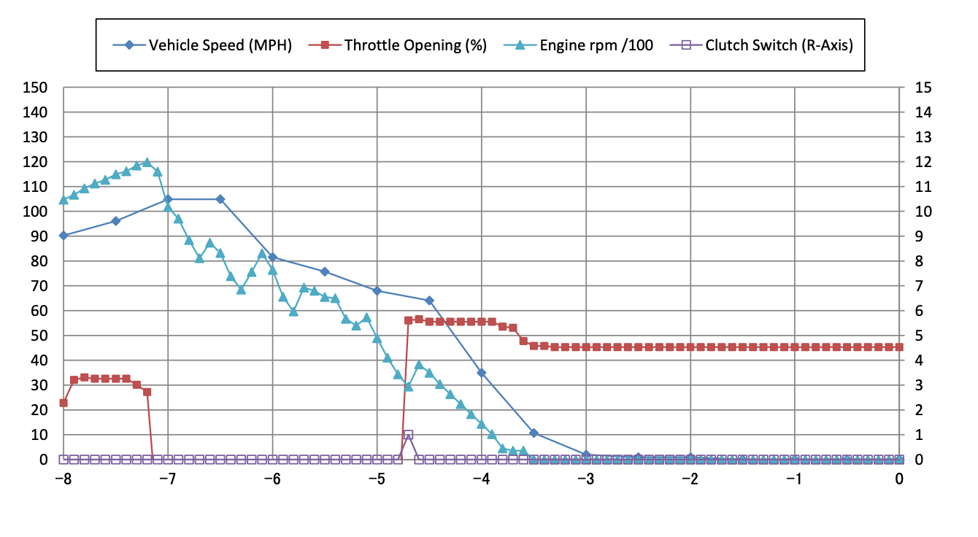
EDR for Motorcycles
Accident Analyses (1)
Diagram 2: Event data recordings (correction in legenda: MPH = km/h)
Notes:
Here you can see data from the EDR. What can we extract from this diagram: time of impact is between -4.5 and -4 seconds. At -7.5 seconds the motorcyclist releases the throttle and reduces speed to 80 km/h in 1 second, a deceleration of 6 m/s². The next second, speed is reduced to 70 km/h, this is the speedlimit at the crossing.
The regular collision analysis confirmed exactly the value from the EDR.

Slide 9
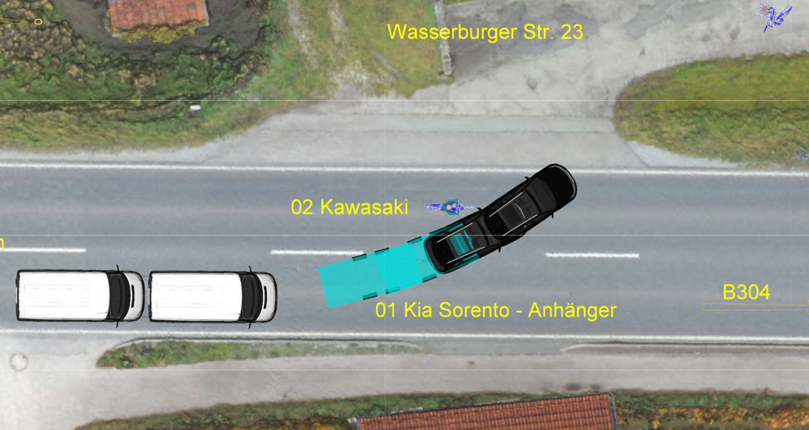
EDR for Motorcycles
Accident Analyses (2)
Image 3: Collision situation case B
Notes:
In this case, the vehicles initially drove in a column, up front the combination of car and trailer which turned left at the very same moment as the motorcycle (nr. 02) overtook the van behind the car and trailer.
The motorcycle is thrown to the left after the impact, the motorcyclist is thrown straight ahead over the turning car and lands further down the street.
The job for the expert involved was to determine whether the driver of the car-trailer combination could have seen the motorcycle or determine how long the motorcycle had been driving in the left lane. It turned out that the driver of the car-trailer combination could not see the motorcycle at the moment of the turn because it was obscured by the following white van. And the motorcyclist did not ride too fast.

Slide 10
EDR for Motorcycles
Accident Analyses (2)
Diagram 3: displacement-time diagram case B
Notes:
Reconstruction using skidmarks etc. shows the displacement of the motorcycle as a function of time. How this diagram came out is not the subject of this paper, but it also suggests it is difficult to get a more high-frequency analysis.
For this case we focus at only one quantity, speed. Among other items, speeds at different moments in time were derived. This analysis doesn’t point at extraordinary speed right before impact, namely 60 km/h.

Slide 11
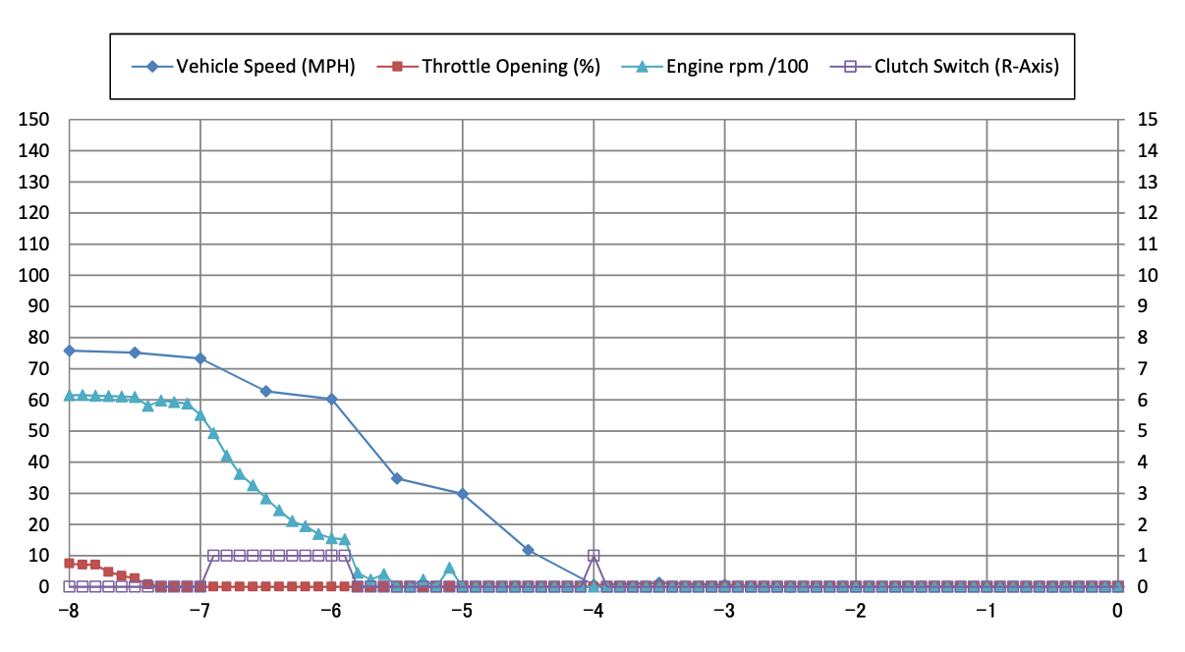
EDR for Motorcycles
Accident Analyses (2)
Diagram 4: Event data recordings (correction in legenda: MPH = km/h)
Notes:
As we can see in diagram 4, approximately 2 seconds ( t = - 8 ) before impact (between t = - 6 and t = - 5,5) the speed of the motorcycle was 75 km/hour. This is an accurate and plausable speed because at such a moment and situation there isn't any slip of the rear wheel for example.
These examples show us EDR data leads tot proper information about motorcycle behaviour (or driver) in case of events like accidents.

Slide 12
EDR for Motorcycles
Conclusions & recommendations (1)
Answers to the research questions:
Technical solutions for EDR in motorcycles are within reach or available and ready for large scale implementation.
EDR-data can enhance and enrich analyses on accident causation and vehicle behaviour in case of impactful events.
EDR on Motorcycles will help to understand how and why accidents happen and can contribute to the development of a safer motorcycling.
Notes:
This brings us for now to our conclusions and recommendations. As we all know and if you're a biker you know for sure: motorcycles are vulnerable road users . The fatalities per million driven kilometers are relatively high.
Our studies show EDR-data can enhance and enrich analyses on accident causation and vehicle behaviour in case of impactful events. These experiences with analyses on EDR of motorcycle accidents show promising results, not a priori against the interest of the motorcyclist. The results show that EDR data can deliver accident and vehicle dynamics information that lead to a better understanding of motorcycle accidents or near accidents.
Our experience in legislation issues, the desk study and survey along European Head Quarters of motorcycle OEM’s show EDR is not on the agendas yet, although technical solutions for EDR in motorcycles are within reach or available and ready for broad utilisation.

Slide 13
EDR for Motorcycles
Conclusions & recommendations (2)
We recommended the development of a minimum set of parameters that has to be recorded by the EDR in case of an event, a validation program to ensure the reliability and the standardization of the data protocols to allow a single reader for all motorcycle models.
We recommend the European Commission together with the industry takes an active role on the development and standardization and validation of EDR.
MODarts is ready to assist manufacturers and regulators with the implementation of EDR in Motorcycles.
Notes:
These are our recommendations:
We wish all stakeholders to adopt these new technologies to enhance safety of motorcycling. Therefore, it is recommended that further extensive research on this topic will be conducted: we need a validation programm and we need standardisation.
And our call: the European Commission and the Motorcycle Industry should work together in development and standardisation.
We thank you very much for your attention and participation.

