Slide 1
13th International Motorcycle Conference of the ifz
Traffic violations of motorcycle riders in fatal and serious injuries accidents in Sweden
Presenter: Maria Nordqvist
Authors: Maria Nordqvist, Dimitri Margaritis, Jesper Christensen

Slide 2
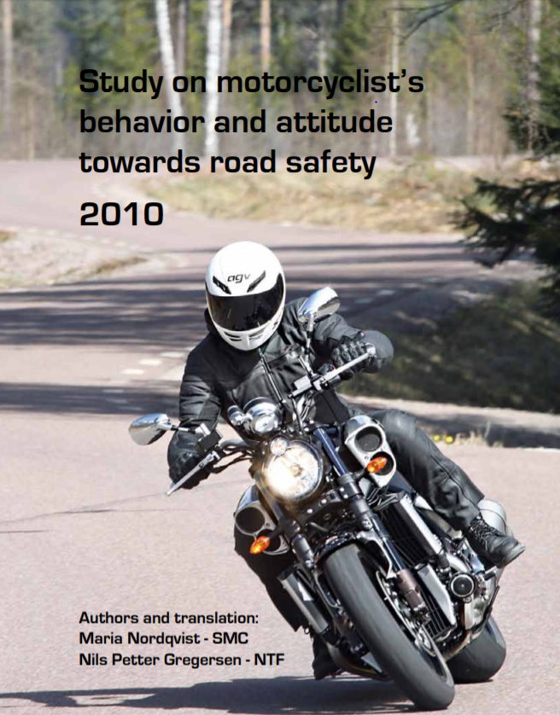
motorcyclists are – in general- safe road users
- 100 % have a valid license
100 % use a helmet
About 90 % always use full protection
Are totally against riding influenced of drugs/alcohol
Buy more advanced training than other road users
Has a better attitude towards safety in all aspects compared to motorists, except one; speed

Slide 3
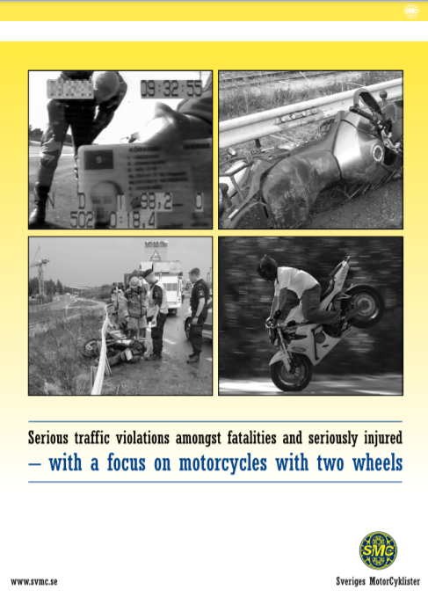
But, many accidents are not about motorcyclists at all!
20 years studying in depth studies of fatalities
From 2011- SMC analyse figures based on license/no license among fatalities
From 2013 - SMC analyse the accidents on the same basis among severly injured
The data collection is a result of a good cooperation with the responsible authorities
A report is presented every year since 2014

Slide 4
fatal accidents based on driver's license 2011-2018
 | Without a license number (%) | With a license, number (%)
Number (share) | 94 (32 %) | 203 (68%)
Average age | 32,6 | 45,64
Alcohol | 23 (24 %) | 14 (7 %)
Promille, average (2011-2017) | 1,698 | 1,13
Drugs | 28 (30%) | 9 (4%)
Both alcohol and drugs | 18 (19 %) | 0
Total affected | 69 (73 %) | 23 (11%)
Without a helmet | 20 (28%) | 7 (3%)
Owner | 48 (52 %) | 177 (87%)
Not in traffic /unregistered/ riding ban | 50(53 %) | 6(3%)
Cross/enduro | 12 (13%) | 1 (0,05)
Stolen motorcycle | 10 (11%) | 0
Total illegal motorcycles | 72 (77%) | 7 (3%)
Single accident | 60 (64%) | 81 (40%)
Collision | 32 (34%) | 112 (55%)
Wild animals | 2 (2 %) | 11 (5 %)
Men (riders and passengers) | 91 (97%) | 192 (95 %)
Women (riders and pass) | 3 (3 %) | 9 (6 %)

Slide 5
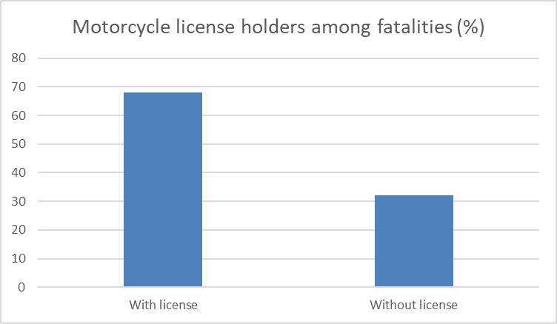
Riding WITHOUT a valid LIcENsE
94 out of 297 fatalities in eight years (2011-2018) didn’t have a valid license (32%)
Average age without license 32.6 years old
Average age among license holders -45.64
97 % of riders/passengers were men

Slide 6
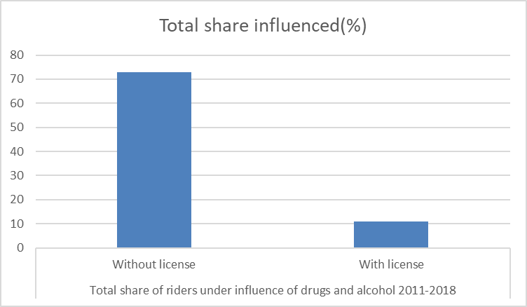
Influenced by alcohol and/or drugs
73 % of killed without a license were affected by alcohol and/or drugs (11 % among license holders)
The per mille level was high, 1,698 for the persons without license, 1,13 with license (0,2 legal limit)
19 % of the affected non-license holders had used both drugs and alcohol
24 % only alcohol, 30 % only drugs
Notes:
.

Slide 7
Helmet use and vehicle ownership
- 23 out of 94 (28%) amongst the fatalities without a valid driver’s license didn’t use a helmet
- 52%, of those who didn’t have a valid driver’s license owned the motorcycle they were riding at the fatal accident (87% amongst license holders).
- The proportion of owners amongst the riders without a valid driver’s license has increased significantly BUT a majority of these vehicles were not allowed to use
- Example year 2017: 13 fatalities without a license. Four used a stolen or borrowed bike. Only one out of nine owners was riding a legal motorcycle!

Slide 8
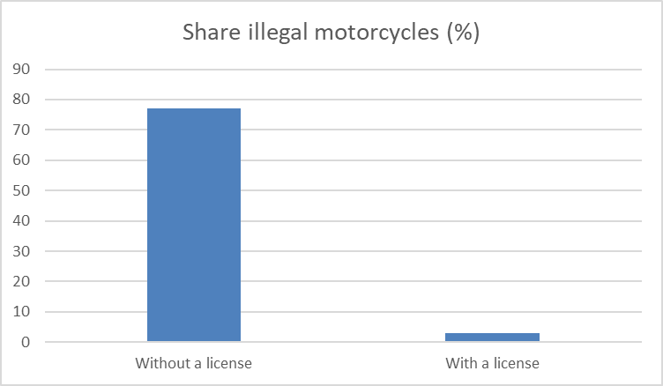
Use of illegal motorcycles
77 % in the group without a valid driver's license rode a motorcycle illegal to use in traffic
The motorcycles were taken out of traffic by the owners (and as a result uninsured, not paid tax, not been to PTI) /unregistered/stolen.

Slide 9
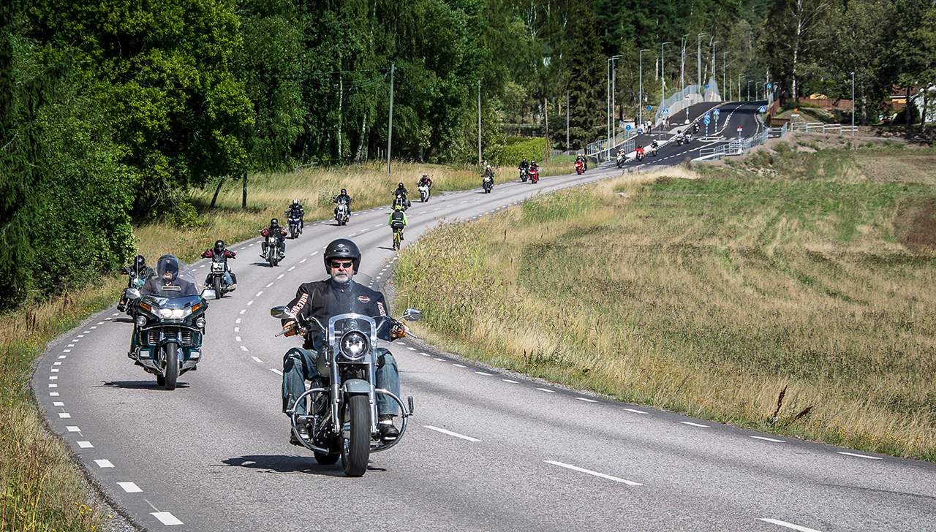
The same result for seriously injured on motorcycles
23 % didn’t have a valid license + 11 unknown = one third
37 % didn’t own the bike (11%)
21 % were riding an illegal bike (5%)
Only 35 % were riding a motorcycle that was insured (89%)!

Slide 10
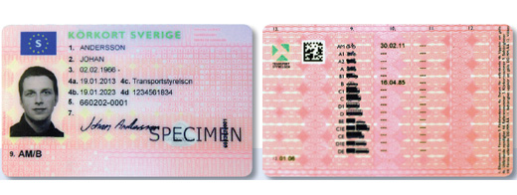
Traditional road safety measures doesn’t work
- Measures like lower speed limits and more median barriers will not reduce these accidents
- A complicated and expensive license education is counterproductive and is not a solution
- Awareness about the problem and the high risk of serious accidents is a start

Slide 11
conclusIONs
A common position that education and license is important for safety is crucial
Annual stats are needed for all road users – to make the right decisions
Which group should be focus for the police?
Increase access to education and tests
How can all systems and stakeholders work together to minimize the problem?
As always - cooperate with the users – we want safety!

Slide 12
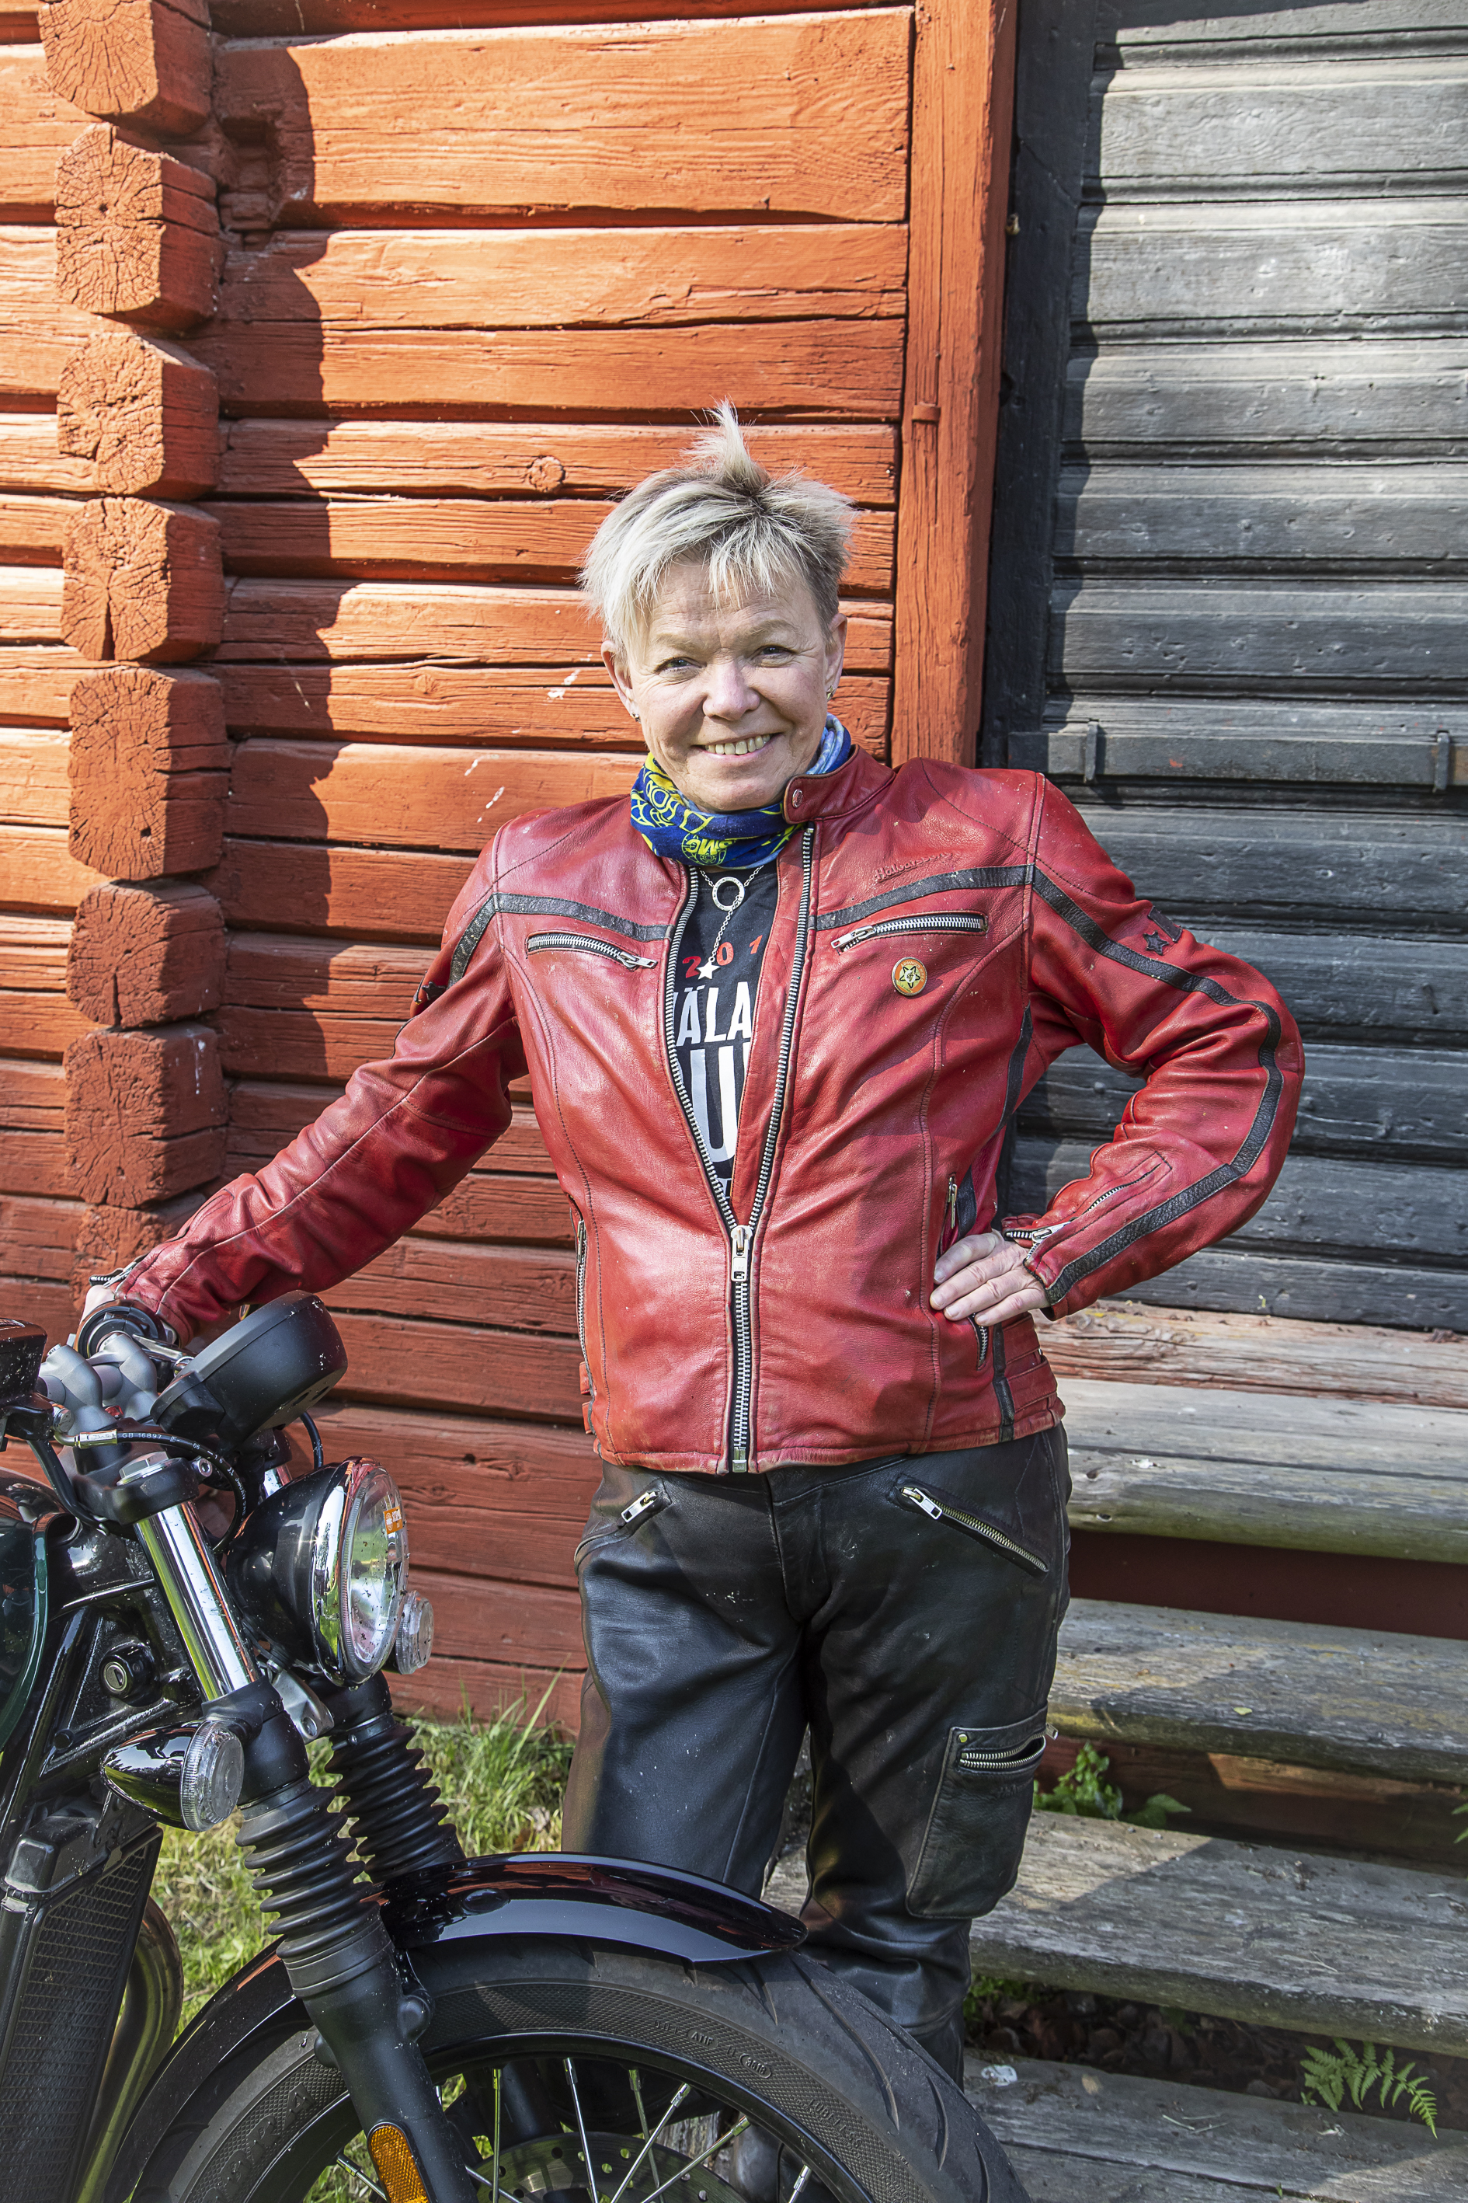
13th International Motorcycle Conference of the ifz
Traffic violations of motorcycle riders in fatal and serious injuries accidents in Sweden
Thank you for your attention!
Presenter: Maria Nordqvist maria.nordqvist@svmc.se

