Slide 1


Avoiding Motorcycle Accidents by Motorcycle Risk Mapping
13th International Motorcycle Conference Cologne
DI Klemens Schwieger, AIT
September 2020
Funded by:

Slide 2

Funding program | 5. VSF (BMK - April 2015) “Freiheit auf 2-Rädern – Aber sicher!”
Coordination | AIT – Austrian Institute of Technology
Partners | TU Wien (Institut for mechanic & mechatronic), [KTM | LoI-Partner]
Project leader | DI Klemens Schwieger
Duration | 01.01.2017 – 31.03.2019

Slide 3


REACTIVE
analyse traffic accidents
→ find black spots
PROACTIVE
analyse driving dynamics data
→ find high risk sites

Slide 4

MOTORCYCLE ACCIDENTS

Slide 5
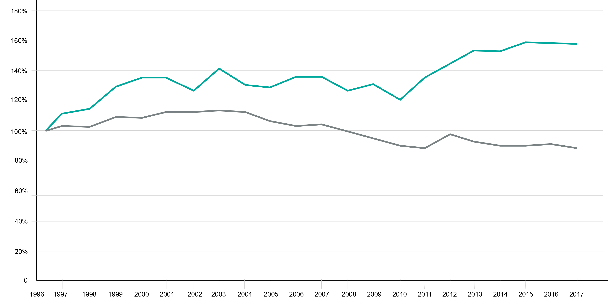


change in method of collection
motorcycle accident with personal injury
car accident with personal injury

Slide 6
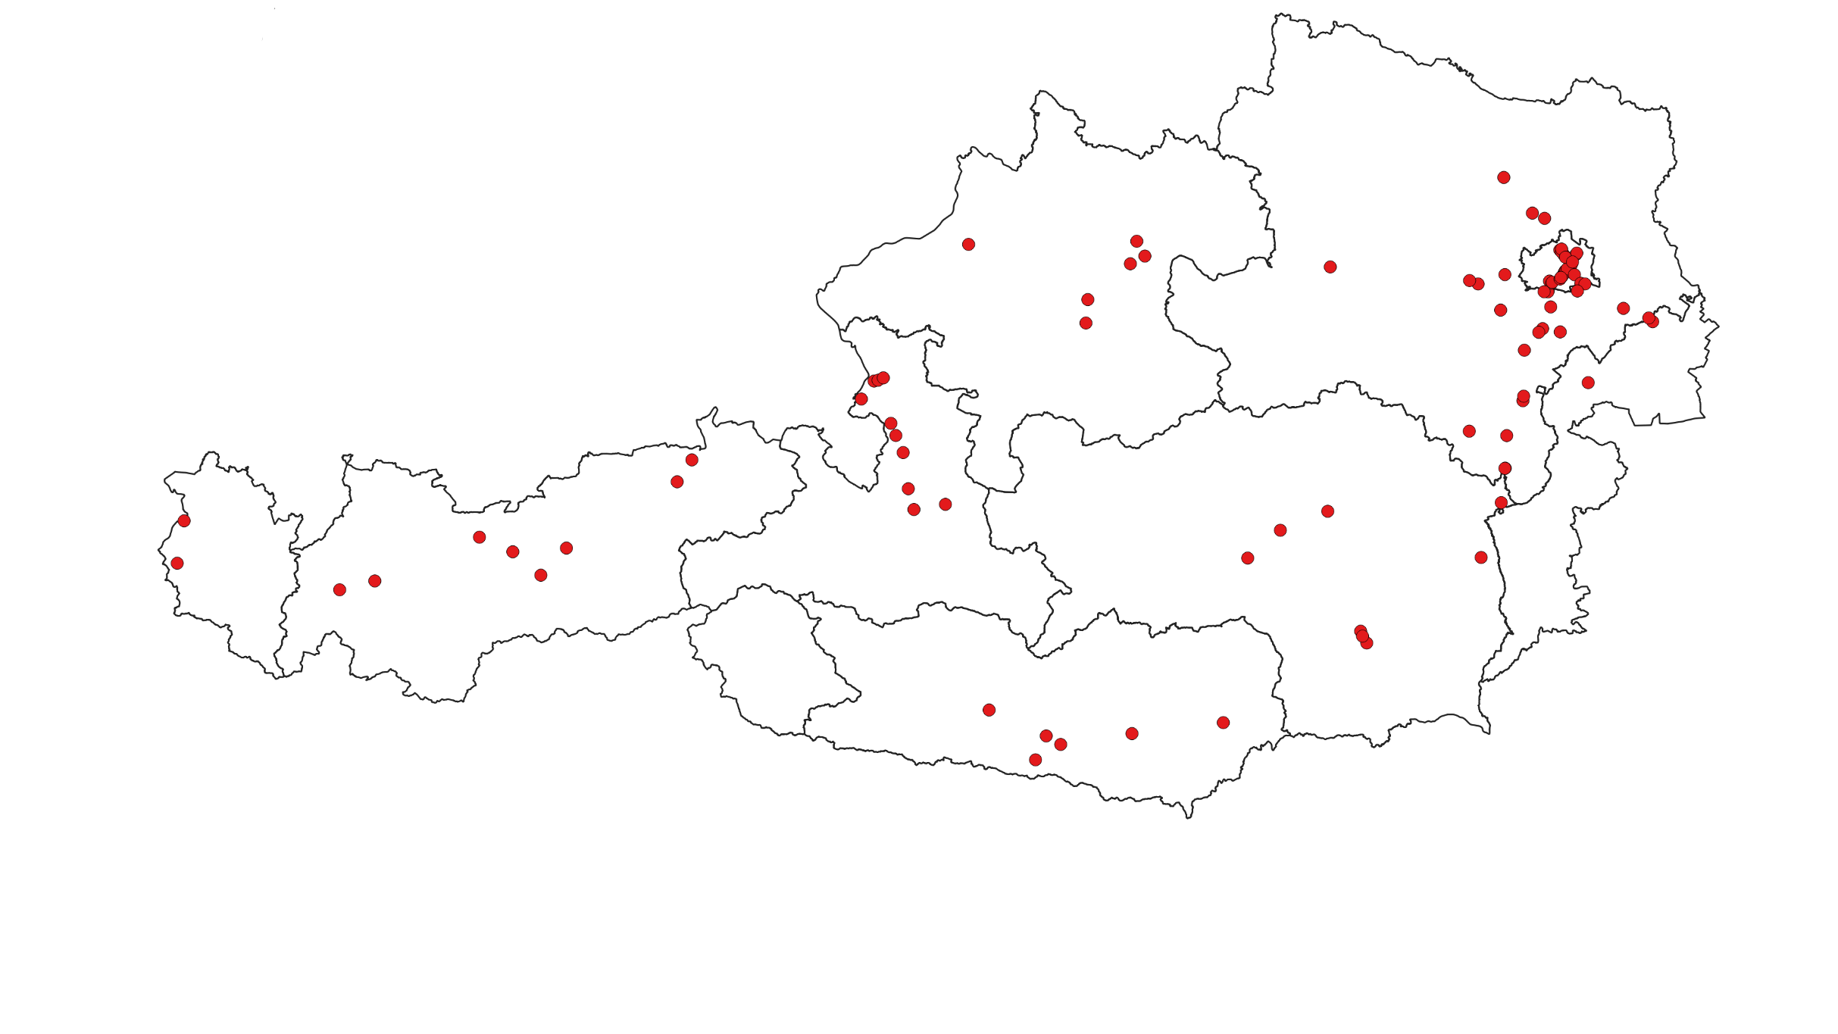
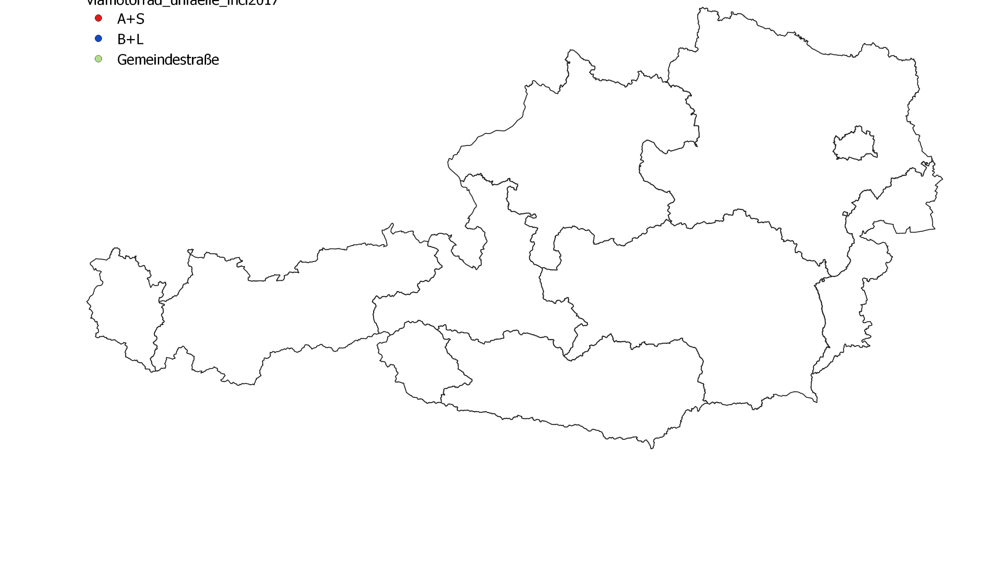
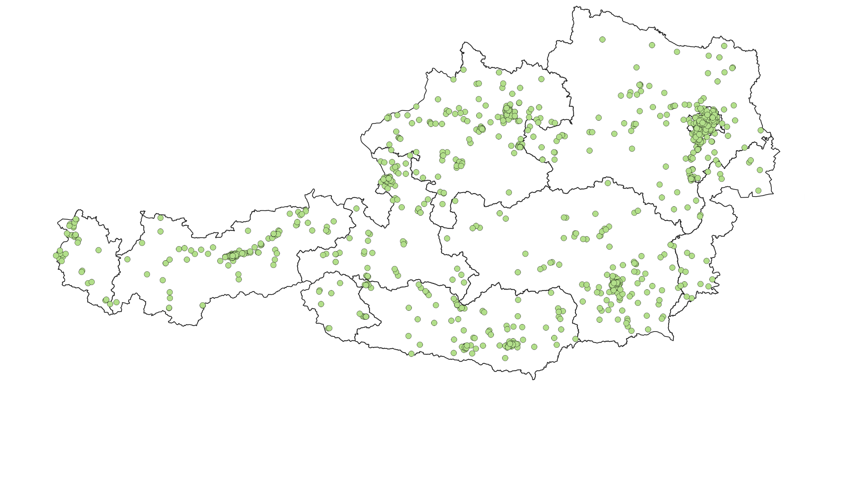
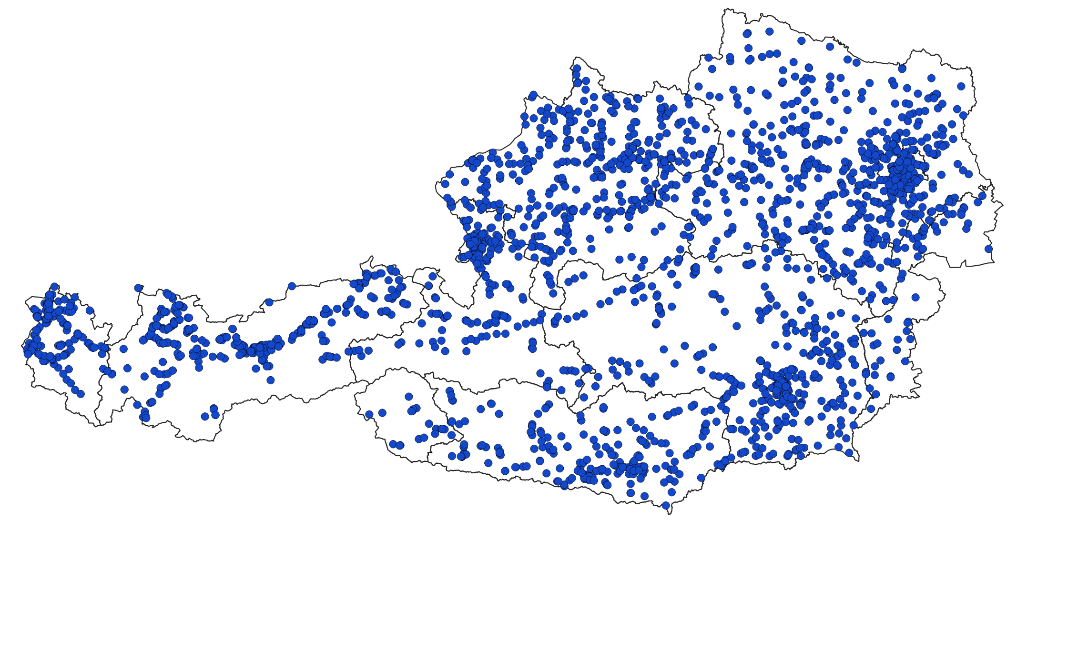
Motorcycle Accidents with personal injury
  in one year on:
  Rural roads
  Municipal roads
  Motorways

Slide 7
REACTIVE
analyse traffic accidents
→ find black spots
PROACTIVE
analyse driving dynamics data
→ find high risk sites

Slide 8
MEASUREMENT SYSTEM

Slide 9
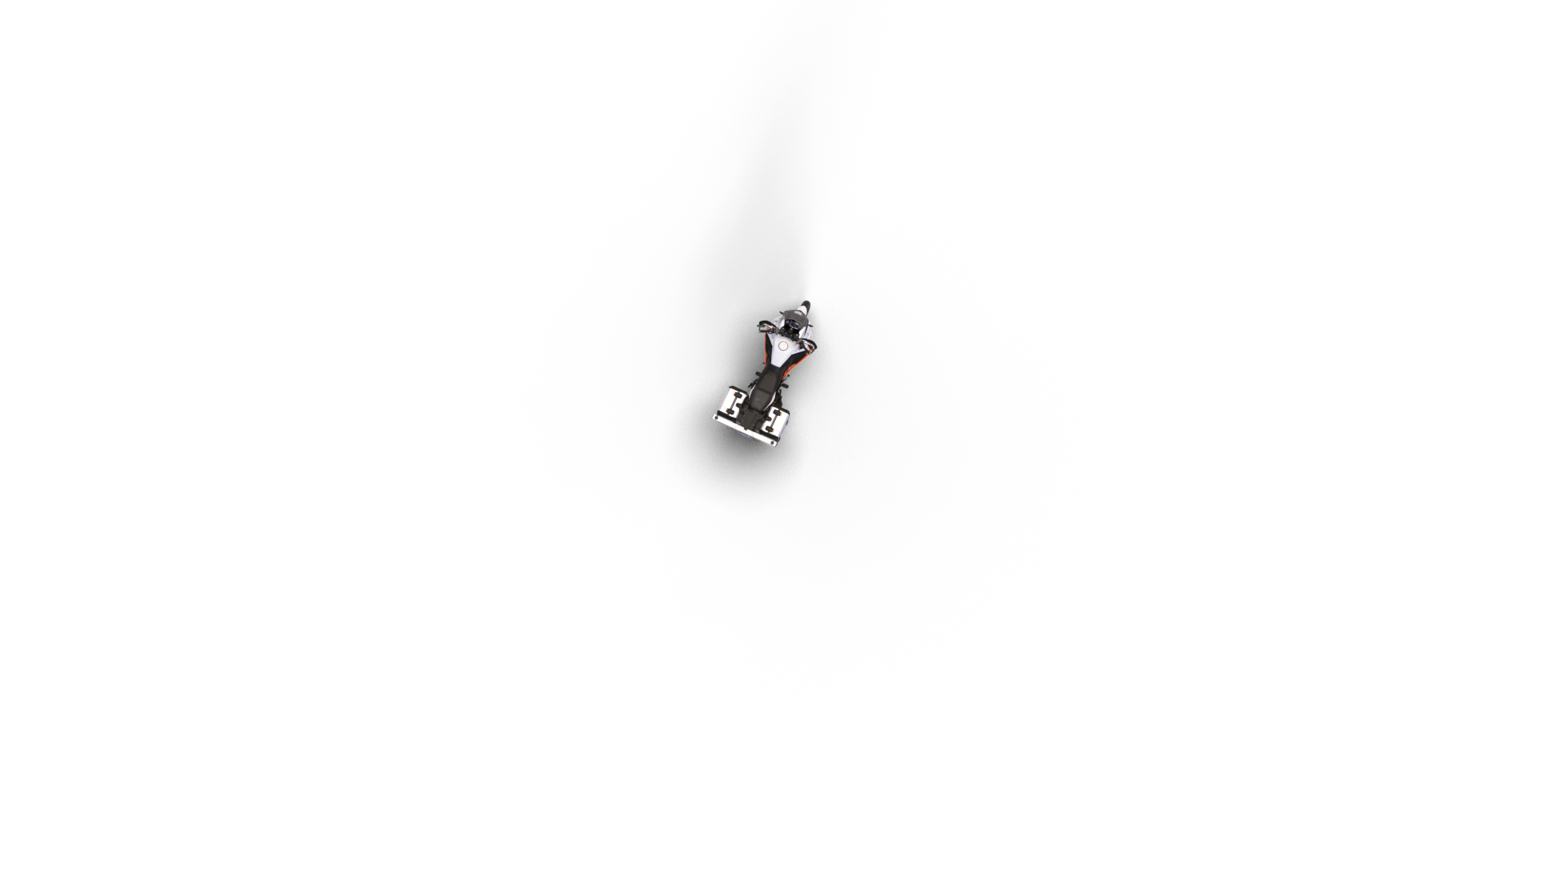

Slide 10
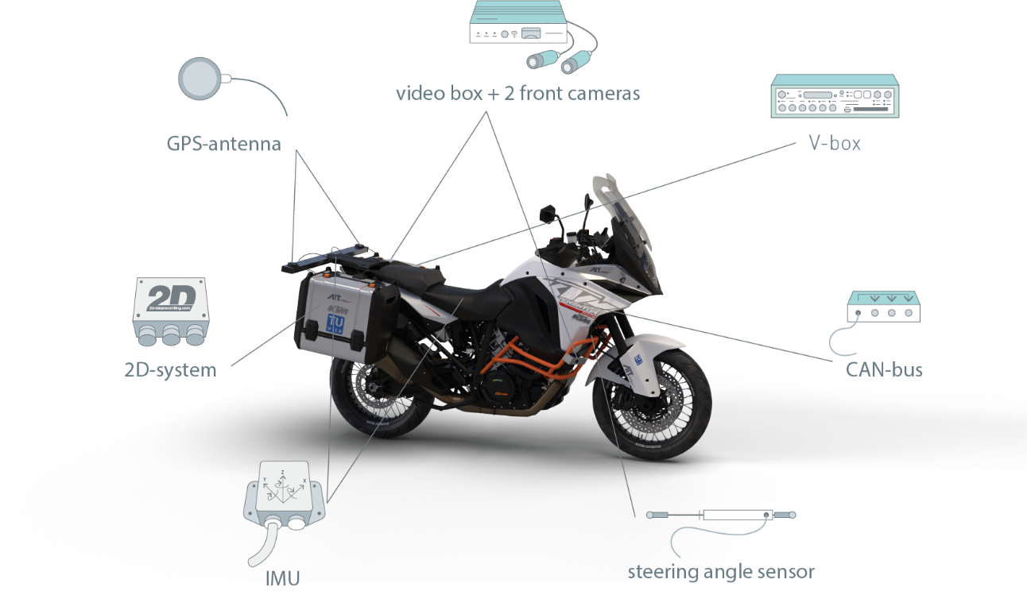

Slide 11




6
6
~3.500
~1
tracks
drivers
km
TB

Slide 12
DATA MINING

Slide 13
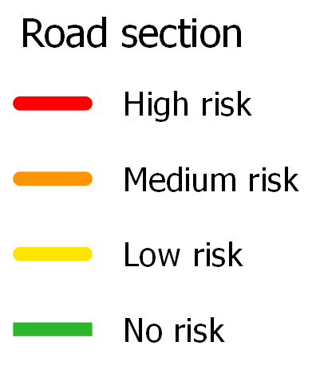
8 values
x, y, z- accelertion
Yaw, Roll, Pitch- Rates
Driven Curve Radius
Slope gradient
Determine dynamics data at historical accident sites
Determine „not at risk“ dynamics values
Weight dynamics variables
risk | no risk
Assign a risk estimate to all
dynamics data
Obtain a joint risk estimate over all rides on a given track
Find local maxima of the risk estimate for each meter of track

Slide 15
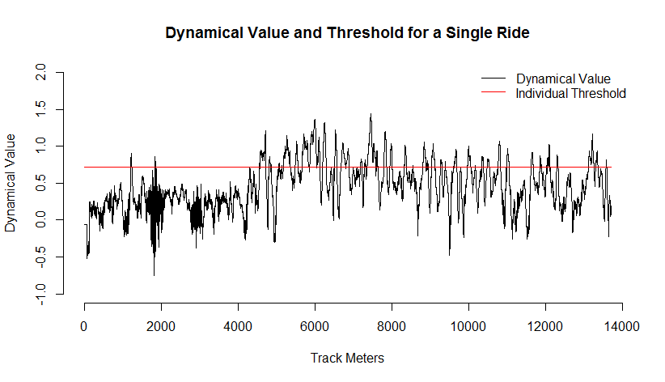

Slide 17
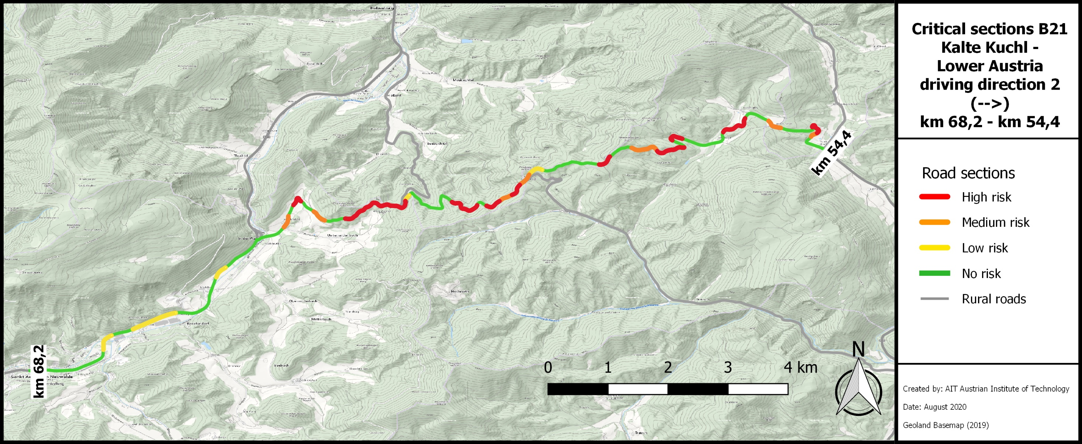

Slide 18
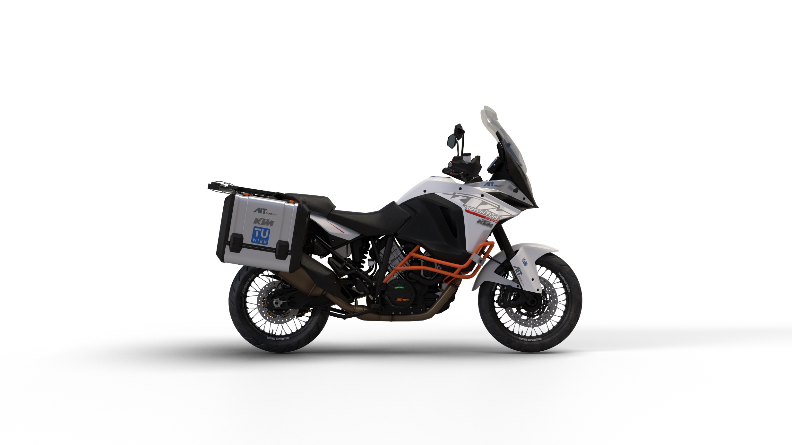
Thank You!
klemens.schwieger@ait.ac.at

