Slide 1
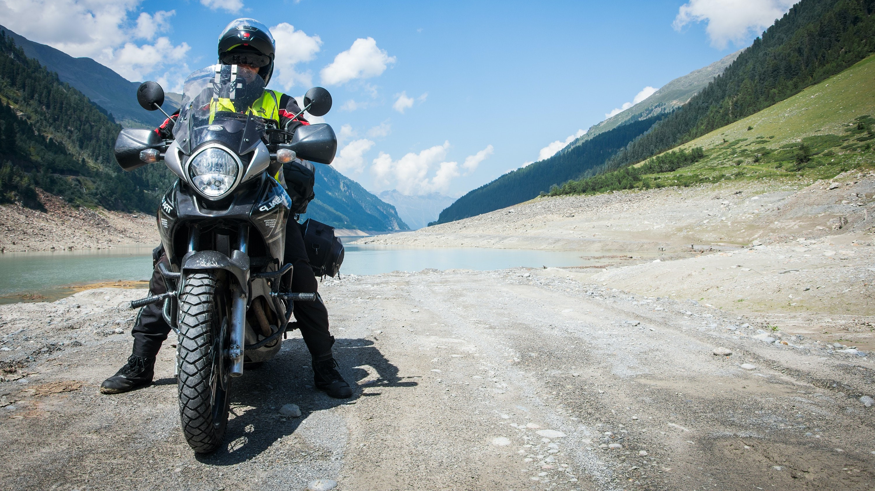
The Development of a 5 Star Motorcycle Clothing Assessment Program
ifz Conference 2020
Author: Brian Wood
Australian Motorcycle Council

Slide 2
Introduction
Motorcyclists’ clothing must
protect the rider from the weather,
be suitable for use at their destination
protect them from injuries in the event of a crash.
Questions
Is crash protection compatible with thermal comfort for motorcyclists in hot conditions?
Can thermal discomfort compromise safe riding, increasing crash risk?

Slide 3
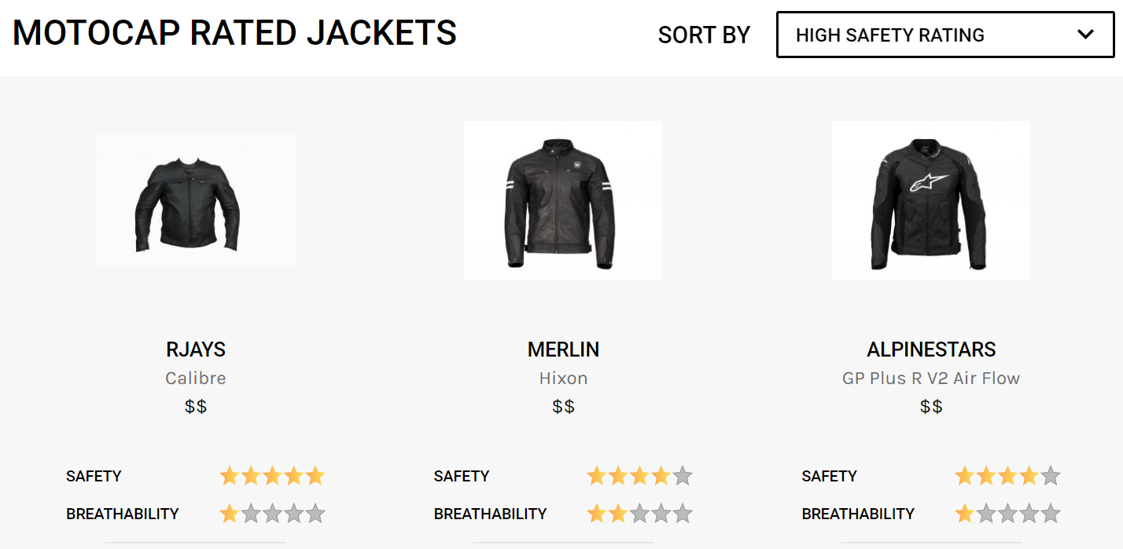
What is the Motocap 5 star ratings scheme
MotoCAP is the Australian and New Zealand Motorcycle Clothing Assessment Program.
The world’s first independent safety ratings system for motorcycle clothing.
The scheme is designed to provide information on the protection and thermal comfort (breathability) of motorcycle clothing so riders can make an informed choice in what they buy.

Slide 4
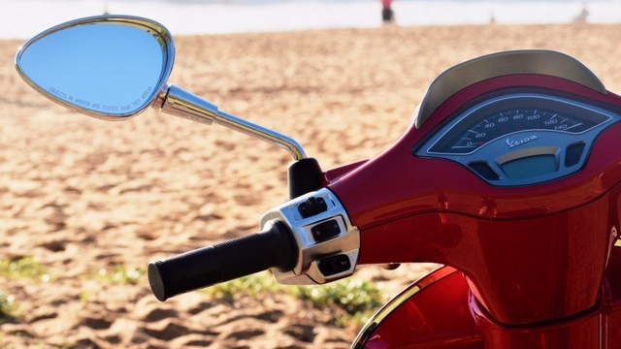
The Australian rider
The climate is variable, with a wide variety of climates due to its large geographical size.
Average 7 hours riding per week (de Rome et al 2016).
Majority ride for recreation (70%)
Over half (53%) commute to work, some (37%) riding larger distances on freeway networks to get to work.
Scooters represent 12% of the fleet

Slide 5
What do Australian riders wear?
Riders look for versatility and adaptability in garments.
Controllable venting - a rider in Victoria who may experience 12°C on their morning ride which increases too 33°C as the day proceeds.
Breathable rain protection - for a Sydney commuter with common afternoon storms in coastal New South Wales.

Slide 6
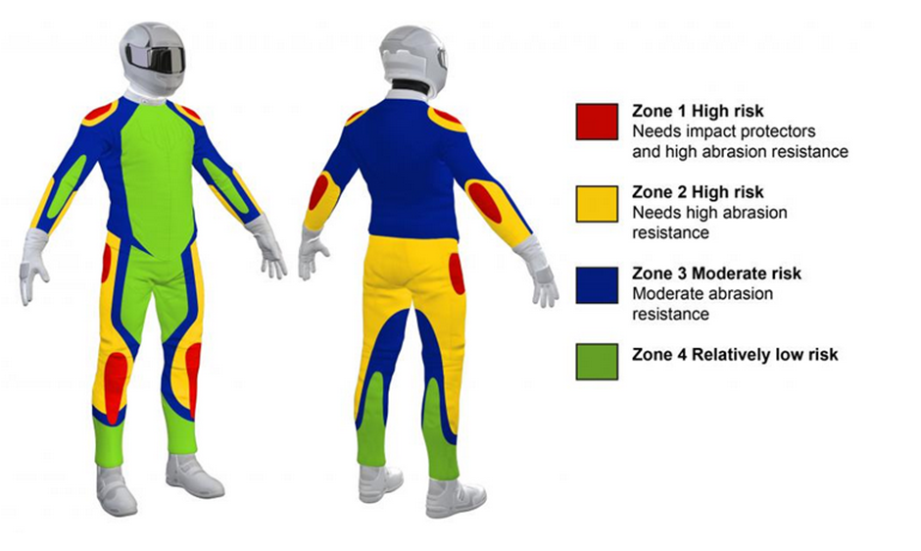
The 5 star rating scheme tests
A mix of the best sellers on the market and lesser-known brands.
One of each item is bought from a retail store and the second is bought online.
Garments are tested for -
impact abrasion,
seam burst strength,
armour energy attenuation,
jackets and pants have additional testing for thermal comfort (breathability).
Follow existing European Standard EN13595-1:2002 with some modifications.
Glove testing follows the tests outlined in EN13594:2003.

Slide 7
How MotoCAP works
Test 152 randomly selected garments per year (10% of motorcycle gear available in Australia)
Over 200 garments have been tested, rated and published for riders to view worldwide.
The objectives of MotoCAP are :
Enable riders to make informed decisions when buying gear;
Increase demand for better performing gear;
Allow riders to compare products on independently tested measures;
Encourage industry to compare their products with those of their competitors;
Providing incentives for industry to compete on safety and thermal comfort; and
Improve overall safety for the riding community.

Slide 8
Partners of MotoCAP
The MotoCAP working group is chaired, managed and administered by Transport for NSW.
Other members include:
Government Agencies
Compulsory Third Party Injury Insurance Agencies
Insurance Companies
Independent Body - Australian Motorcycle Council
Consultants - Dr Chris Hurren and Dr Liz de Rome from Deakin University for Frontier Materials

Slide 9
Key milestones of the development of the 5 star rating scheme
2003 –
The Motorcycle Council of NSW (MCC) investigate the features of effective motorcycle personal protective equipment (PPE). (de Rome 2002, 2004b, a).
2005 –
A national PPE industry seminar was held by the MCC with the support and funding of the MAA to consider the European Standards for PPE (de Rome et al 2005).
2007 –
The National Roads and Motorists Association (NRMA) fund a survey of novice riders to establish their knowledge, information sources and usage of PPE (de Rome et al 2010, de Rome et al 2011b).
2008 –
Swann Motorcycle Insurance fund a study of the injury reduction benefits of the clothing worn by injured and un-injured riders involved serious crashes.
PPE researcher invited to give a presentation on protective clothing research to members at the AMC Annual Conference
2009 –
AMC successfully lobbied Federal Government for funding to publish and distribute a guide to riders on the features of effective motorcycle protective clothing ‘The Good Gear Guide’ (de Rome, 2009).

Slide 10
Key milestones of the development of the 5 star rating scheme (continued)
2011–
The Australian and New Zealand Government Injury Insurance agencies commission industry consultations and research into the development of a model for providing riders with reliable information when buying motorcycle protective gear (de Rome et al 2012a).
The Victorian Transport Accident Commission (TAC) organise a series of state-wide seminars on the testing and other assessments of motorcyclists’ clothing, inviting riders, retailers and clothing suppliers.
2014 –
The AMC forms a Protective Clothing Sub-Committee and develop a Position Statement on Protective Clothing from a rider’s perspective
AMC Annual Conferences in 2014-16 invite PPE researchers to provide updates on research progress on protective clothing.
2015 –
The AMC collate and list CE approved gear available in Australia on its website to assist riders in choosing suitable gear.
The AMC join the Australian and New Zealand Working Group to develop a 5 Star Rating scheme.
The Motorcycle Protective Clothing working group formed, consisting of 10 members from government agencies and motoring clubs, led by the TAC.

Slide 11
Key milestones of the development of the 5 star rating scheme (continued)
2016 –
The science program ‘Catalyst’ produce a segment on motorcycle protective clothing, this was broadcast by the national broadcaster, the Australian Broadcasting Commission (ABC) - https://www.abc.net.au/catalyst/motorcycle-clothing/11016386
The Transport for NSW, assume lead role for the Motorcycle Protective Clothing working group and commission the development of test protocols for a PPE star rating scheme in consultation with industry (de Rome et al 2016). Transport for NSW actively seek interested parties, and the consortium grows to 20 members including the AMC.
Dr Liz de Rome and Dr Chris Hurren from Deakin University Institute for Frontier Materials are contracted to develop test and rating protocols for motorcycle protective clothing.
The test protocols are distributed for comment to the motorcycle accessories industry in Australia and New Zealand, including local manufacturers and importers.
2018 –
Dr Liz de Rome and Dr Chris Hurren are contracted to the consortium to conduct testing of motorcycle protective clothing for publication under the MotoCAP program.
The Motorcycle Clothing Assessment Program, and the accompanying website, www.motocap.com.au launched by the MotoCAP working group, and includes twenty gear items rated.
2020 -
MotoCAP have rated 128 products on the website.

Slide 12
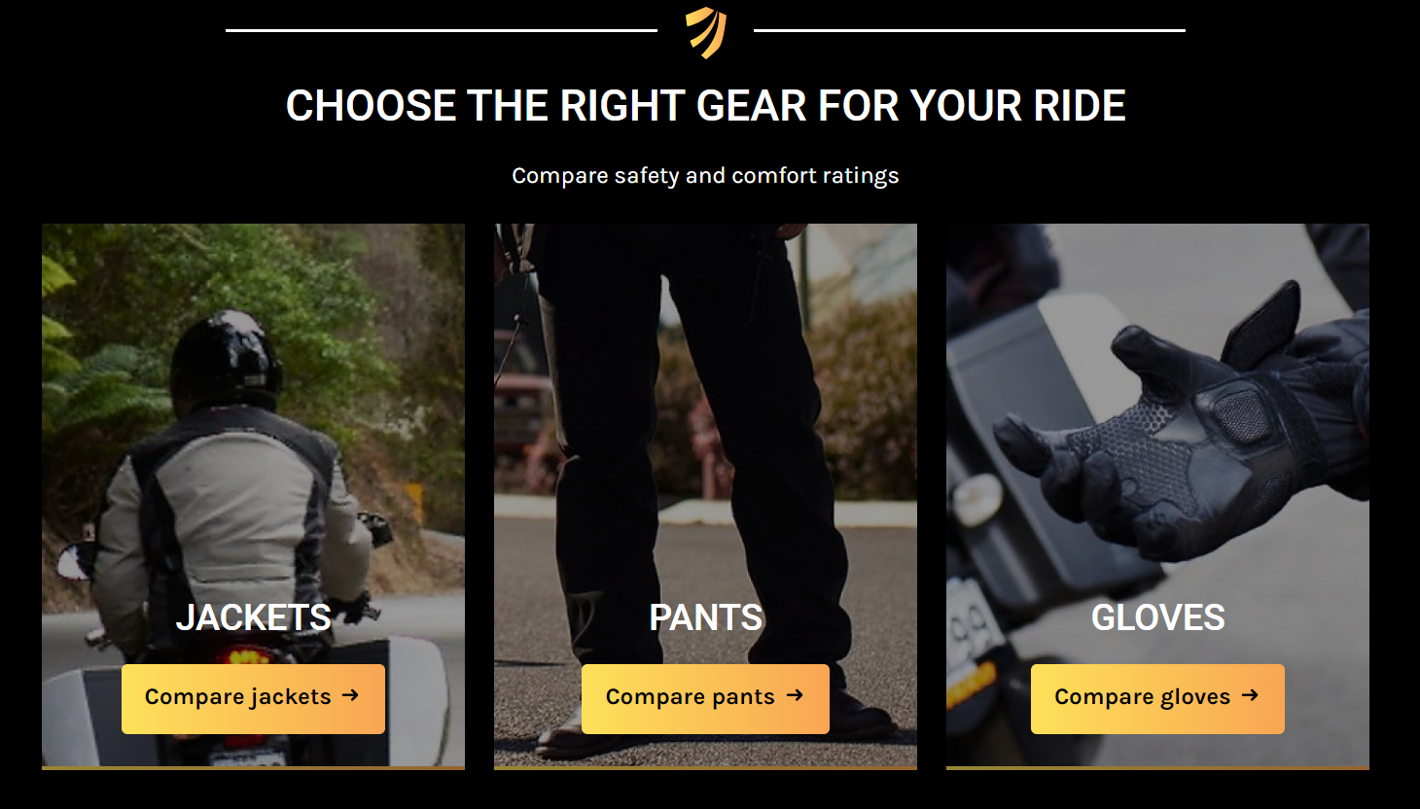
Why stars and not a standard?
Consumer/rider centric test
Appropriate for Australia’s diverse climate
Provides a market incentive for manufacturers to improve the quality of their gear
Helps riders make informed decisions about what is best for them

Slide 13
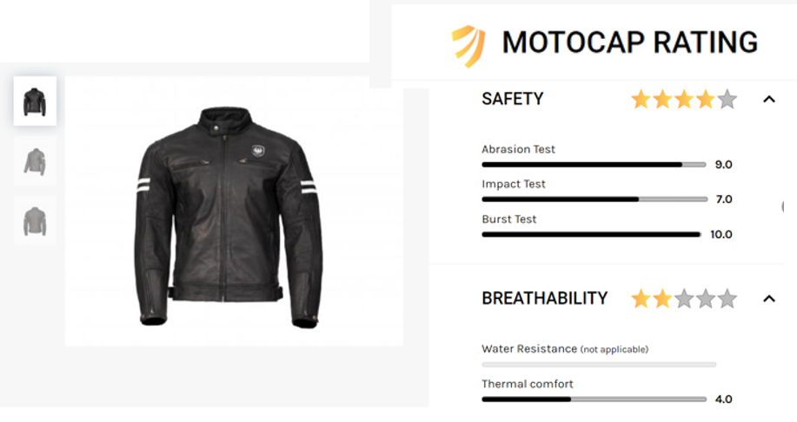
How MotoCAP is influencing the market - Consumers -
‘When I retired, I was given a leather jacket. I had been told that when leather is treated to make it soft, it can destroy its abrasion resistance. I was reluctant to wear the jacket not knowing how good it was. It hung in my wardrobe for 2 years until it came up on MotoCAP and it rated fairly well. I’m now quite happy to wear it.’

Slide 14
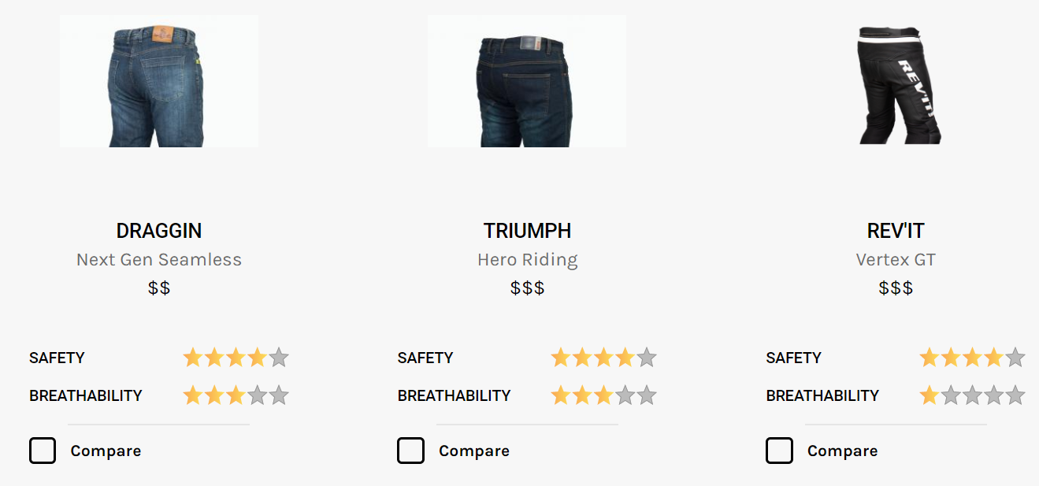
How MotoCAP is influencing the market - Manufacturers -
Australian company Draggin Jeans, were about to discontinue their range of Next Gen Seamless jeans just before their protective jeans were awarded a 4 star safety rating and a 3 star comfort rating.
Two small Australian start-up companies have purchased laboratory testing time to develop their protective motorcycle gear.
An Australian state government protective agency have used the MotoCAP testing facilities to influence their decision before issuing standard uniform.
Some motorcycle gear manufacturers identified the Darmstadt Abrasion machine cannot be used in research and development to compare the performance of different materials but use the MotoCAP published results (from the Cambridge machine test) to compare with the result of their competitors garments.

Slide 15
The future of MotoCAP
More publicity of website
22,000 unique visitors since Sept 2018
1,300 subscribed to receive updates of new gear tested and listed
78% of visitors originate from Australia and NZ, 8% from Europe
More products
More manufacturers and importers to fund research of the protective and comfort ratings of their motorcycle gear.
Worldwide 5 star scheme
Other countries to adopt the MotoCAP test protocols and ratings methodology, which are published and available on application.
The current MotoCap website is available to riders and the industry globally.

Slide 16
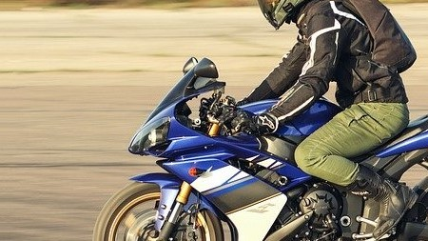
Conclusion
The introduction of a 5 star Scheme was supported by riders right from the start.
MotoCAP allows riders to have options on what they buy depending on their needs and likes.
MotoCAP educates riders and manufacturers on what features of a garment make it protective.

