Slide 1

Optimized protective clothing for motorcyclists:
Which safety benefit can airbag-clothes deliver?
13th International Motorcycle Conference, 2020
Dr.-Ing. Matthias Kühn, German Insurers Accident Research, Berlin
Frau Antje Lang, German Insurers Accident Research, Berlin
Dr. rer. biol. hum. Dipl.-Ing. Klaus Bauer (FH), Institute for forensic medicine at LMU , Munich
Prof. Dr. rer. biol. hum. Dipl.-Ing. Steffen Peldschus, Institute for forensic medicine at LMU , Munich

Slide 2
Agenda
Introduction
Underlying data and methodology
Injuries and most often involved body regions
Kinematic analysis and typical impact parameters
Simulation of typical impact situations and injury-related mechanical assessment
Recommendations on the protection offered by optimized protective clothing

Slide 3
Introduction
Motorcyclists still have a significantly higher risk than car occupants of being injured or even killed in an accident.
in relation to the covered distance, motorcyclists have a 20 times higher risk of being killed in a road accident than car occupants (2017).
The level of risk is constantly increasing.
The impact, the motorcyclist’s body may have to absorb most of the energy involved.
Accordingly, there is significant scope for optimizing the protective clothing of motorcyclists. In particular, new developments such as airbags in protective clothing are highly promising.
The aim of this project is
to study the accidents that occur in order to identify typical accident situations and impact scenarios.
to rank the regions of the body most badly affected
to selected “optimized protective clothing” which will be thoroughly assessed in terms of its potential to prevent injuries and mitigate the severity of any injuries.

Slide 4
Underlying data and methodology
Database:
Three accident samples were available
76 fatal motorcycle accidents from the years 2004 to 2014 provided by the institute for forensic medicine at LMU
55 fatal motorcycle accidents from the years 2003 to 2016 provided by a firm of accident analyst experts
156 motorcycle accidents documented in the accident database (UDB) from German Insureres Accident Research
Methodology:
Based on typical accident situations and impact scenarios the most affected body regions were ranked
for some particularly relevant accident situations, multi-body system simulations (PC-Crash and Madymo) were carried out in order to get impact parameters (e.g. forces, velocity direction of body parts)
based on these results, detailed finite-element model simulations (FEM) using human model (GHBMC ) were carried out in order to assess and categorize the injury risk and the potential of optimized protective clothing

Slide 5

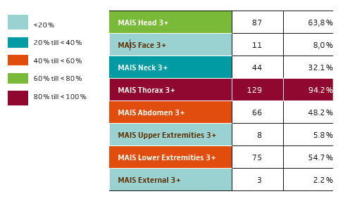
Injuries and most often involved body regions
Despite the fact that head injuries in the samples studied were also high, in this project this head region was not analysed.
94 per cent of all motorcyclists or pillion passengers had serious thoracic injuries at the level of MAIS 3+
Frequent injuries included haemothorax, fractured ribs and lung injuries.
Injuries to the thoracic aorta were found in around a third of the motorcyclists involved
Among the 44 motorcyclists and pillion passengers with MAIS 2 injuries (UDB), injuries to the extremities were most common, and thoracic injuries were of only secondary relevance.
Percentage of people killed who had at least one serious injury (AIS 3+) in the regions of the body shown (LMU, n=137)

Slide 6
Kinematic analysis and typical impact parameters
Based on the results of the kinematic analysis, the following key areas of focus can be identified for the thorax in the relevant impact scenarios:
Impact with the road (vertical speed of around 17 km/h)
Impact with an object with a radius of around 0.075 m, impact speed of around 25 km/h
Impact with an object with a radius of around 0.075 m, impact speed of around 60 km/h
Impact with an object with a radius of around 0.25 m, impact speed of around 50 km/h
One particularly relevant impact scenario (motorcyclist collides with the side of a car crossing its path) was transferred into a multi-body simulations model to calculate the impact parameters of the motorcyclist (speed, orientation and point of impact.)
Multi-body simulation of the impact of a motorcyclist with the side of a car

Slide 7
Simulation of typical impact situations and injury-related mechanical assessment
FEM simulations with
50th percentile male model of the Global Human Body Model Consortium (GHBMC)
A generic thorax airbag. In this project the airbag concept was used as optimized protective clothing.
The performance of the generic thorax airbag corresponds with today commercially available thorax airbags and was validated using hardware tests conducted at DEKRA test facility Klettwitz (Germany) according to test conditions specified by EN 1621-4.
FEM human model (GHBMC) and generic thorax airbag model
Essential setup of the FEM simulation of a generic scenario (radius of the object involved in the impact: 0.075 m)

Slide 8
FEM simulation of the impact of a motorcyclist with the edge of a car’s roof
Condition before the collision
Deformation during the collision

Slide 9
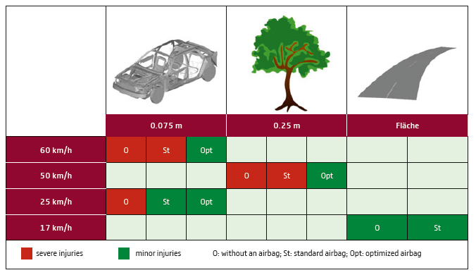
Simulation of typical impact situations and injury-related mechanical assessment

Slide 10
Recommendations on the protection offered by optimized protective clothing
The higher the speed of the impact and the smaller the radius of the object involved in the impact, the smaller is the protective effect that can be expected.
As of a speed of impact of at most 50 km/h, no appreciable mitigation of injury severity can be expected.
Even a significantly optimized airbag, which can still have a protective effect in this speed range, is no longer effective as of a speed of impact of at most 70 km/h.
A thorax airbag can offer good protection in minor accidents, in particular. However, thorax injuries do not occur often in this group of minor accidents and are also not always very serious. In more serious accidents at higher speeds of impact, the relevance of serious thorax injuries increases significantly. However, the protective potential of airbags in protective clothing decreases to the same extent.
Today’s commercially available thorax airbags can mitigate injuries at lower speeds of impact. The benefits should therefore be rated as acceptable, but given the overall context, they should be viewed as controversial.
There needs to be a discussion about adapting the test parameters for optimized protective clothing developed in the future. In particular, the test weight used and the test speed should be increased appropriately.

Slide 11
Dr.-Ing. Matthias Kühn, German Insurers Accident Research
m.kuehn@gdv.de

